Slide 1

DBA in the Cloud
Deepthi Goguri

Slide 2


Thank You to our Sponsors!
Gold:
Please patronize our sponsors and thank them for sponsoring! We couldn’t run events like these without the support.
Please patronize our sponsors and thank them for sponsoring! We couldn’t run events like these without the support.

Slide 3

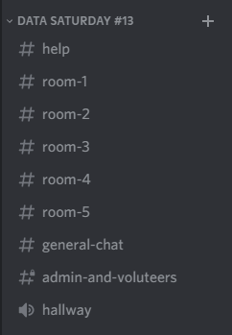

Join The PASSMN Discord Server
https://discord.gg/GajGTFVT28
We’re using Discord as our background chat and communication platform to augment our Virtual Events. This way you can chat with all attendees and continue the conversation after the sessions/event.
Note: Change your Nickname to your First & Last Name so it’s easier to know who you are.
Help Chat:
Session Chat & Q/A:
Example:
Voice Chat:

Slide 4

Deepthi
Goguri
She/Her
Masters in Computer Technology
MCT/MCSE
Organizer for DEI user group and AI South Florida user group
WIT Volunteer
Love Arts and Crafts
SQL Server DBA
Twitter: @dbanuggets
Website: https://dbanuggets.com/
Linkedin: https://www.linkedin.com/in/deepthigoguri/

Slide 5
Overview
Azure – Deployment options
Cloud DBA responsibilities
Service Tiers, Compute tiers
Creating Azure SQL database
Resources

Slide 6
DBA’s, get ready to be a Cloud DBA
Role – Going to expand
Wait, Microsoft is going to take care of everything, correct?
Certain responsibilities!
Existing responsibilities – You still going to use them
New Skills – Yes, you need to learn new skills

Slide 7


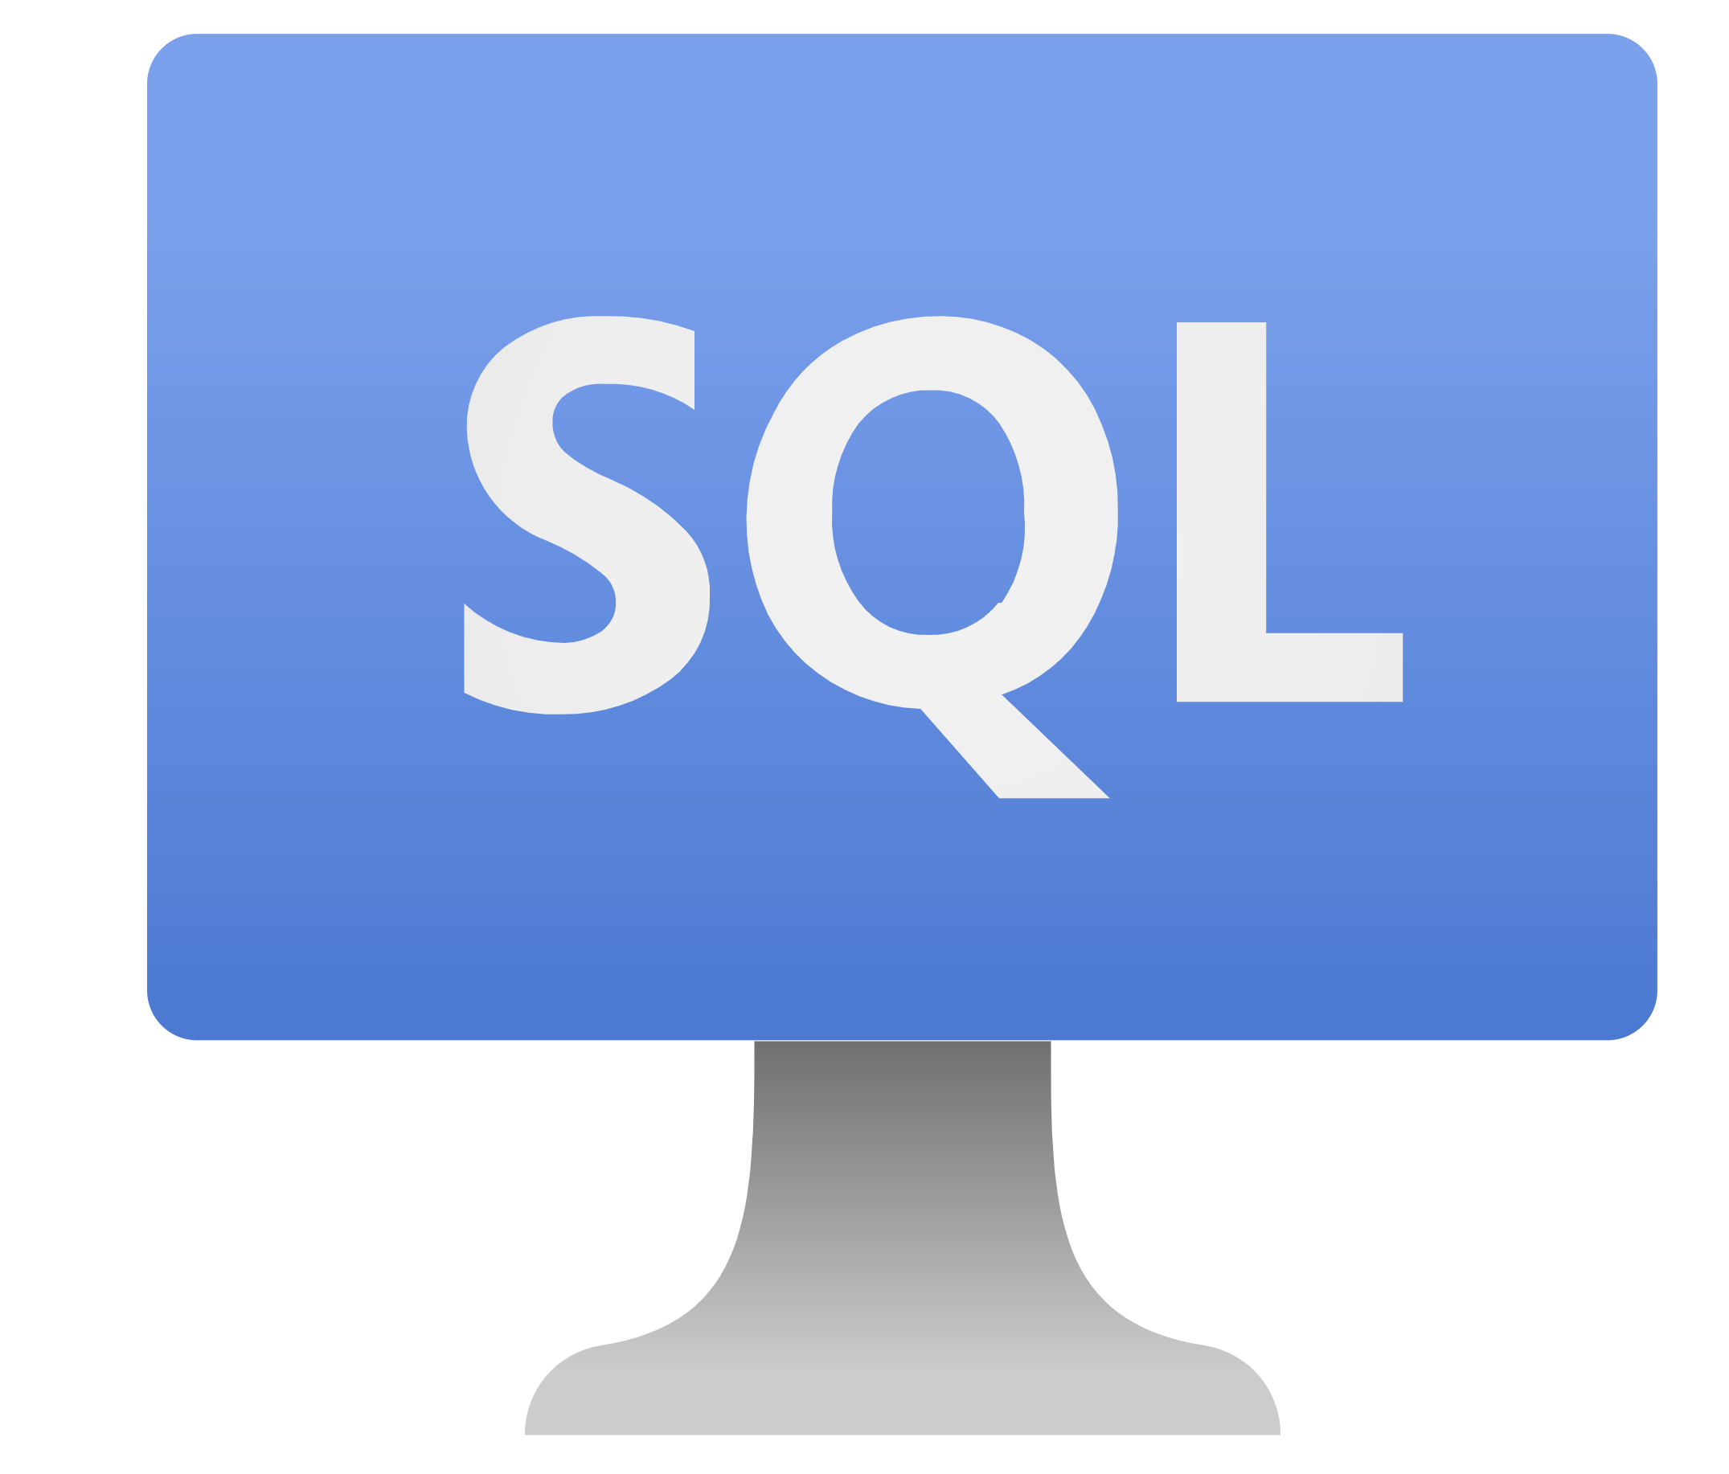
Azure – Deployment options
SQL Server on Azure VM
SQL Managed Instance
Azure SQL DB
IaaS
Infrastructure as a Service
PaaS
Platform as a Service
PaaS
Platform as a Service

Slide 8

Differences
OS and SQL Server access
Version of your choice
Automated backups and security patches
Supports older versions of SQL Server
Images, Iaas Extension
No OS access
Control Instance capabilities
SQL Agent, Dbmail, linked servers, service broker etc.
SQL Database only
No OS or SQL instance
Access to database scoped features only
Modern cloud applications

Slide 9
When to choose what
Flwxibility, scalability

Slide 10
Comparison
Feature | Azure SQL Database | Azure SQL Managed Instance
Change data capture (CDC) | NO | YES
Common language runtime (CLR) | NO | YES
Cross-database/three-part name queries | NO | YES
Cross-database transactions | NO | YES
Database mail | NO | YES
Resource Governor | NO | YES
Automatic tuning (indexes) | YES | NO
SQL Server agent | NO | YES
For all Feature differences: https://docs.microsoft.com/en-us/azure/azure-sql/database/features-comparison

Slide 11
What are my responsibilities?

Slide 12
Use cases
Azure VM
Move to cloud asap
Access to OS
Extended security updates
SSRS, SSAS, SSIS
Managed Instance
Azure SQL database
New cloud applications
No physical hardware
All you need is a database

Slide 13
Responsibilities of Cloud DBA
Cost optimization
Tuning the Queries
Database
Monitoring the performance
Setting up the alerts
Fix any outages
Automating the tasks
Migrations
Designing the plan
Knowing the costs for each service you use
Knowing where to go

Slide 14
Leaving some of the repetitive tasks
Infrastructure, Hardware
Windows upgrades, patches
SQL Server patches
Automated backups
Different levels of security
Automatic tuning (DBA need focus)
Automatic plan correction
Automatic index tuning

Slide 15
Talk to me about the Cost!

Slide 16
Purchasing Models
Purchasing models
DTU (bundle of compute, storage and I/O)
Basic, standard and premium
vCore (choose compute and storage separately)
General purpose, hyperscale and business critical
Azure hybrid benefit
Reserved capacity
SQL managed instance only option
Source: https://docs.microsoft.com/en-us/azure/azure-sql/database/migrate-dtu-to-vcore

Slide 17
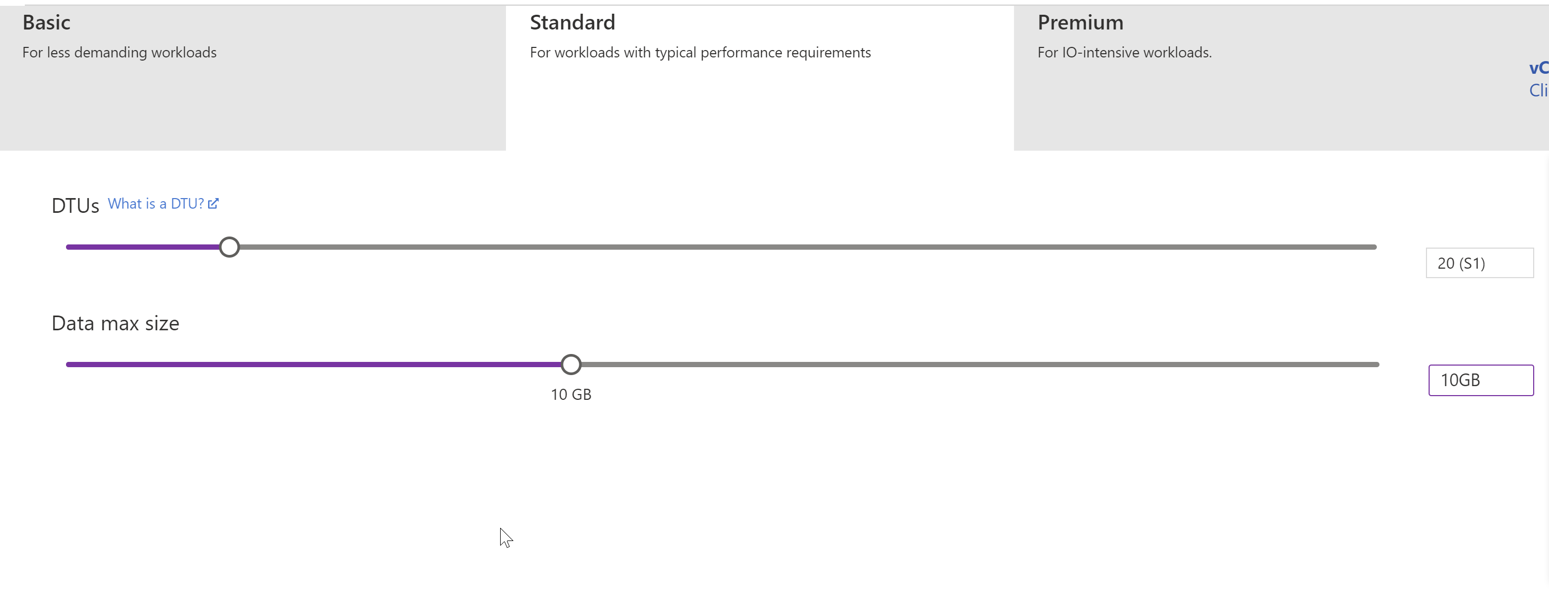
DTU
https://docs.microsoft.com/en-us/azure/azure-sql/database/service-tiers-dtu

Slide 18
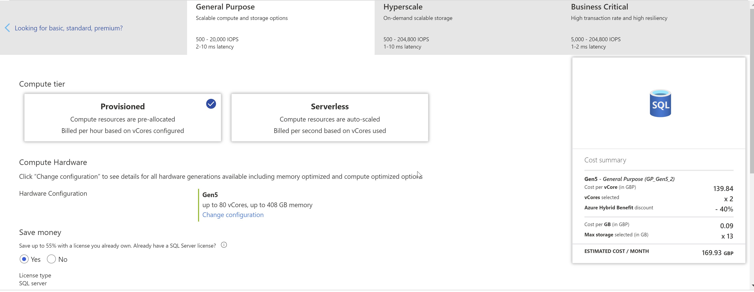
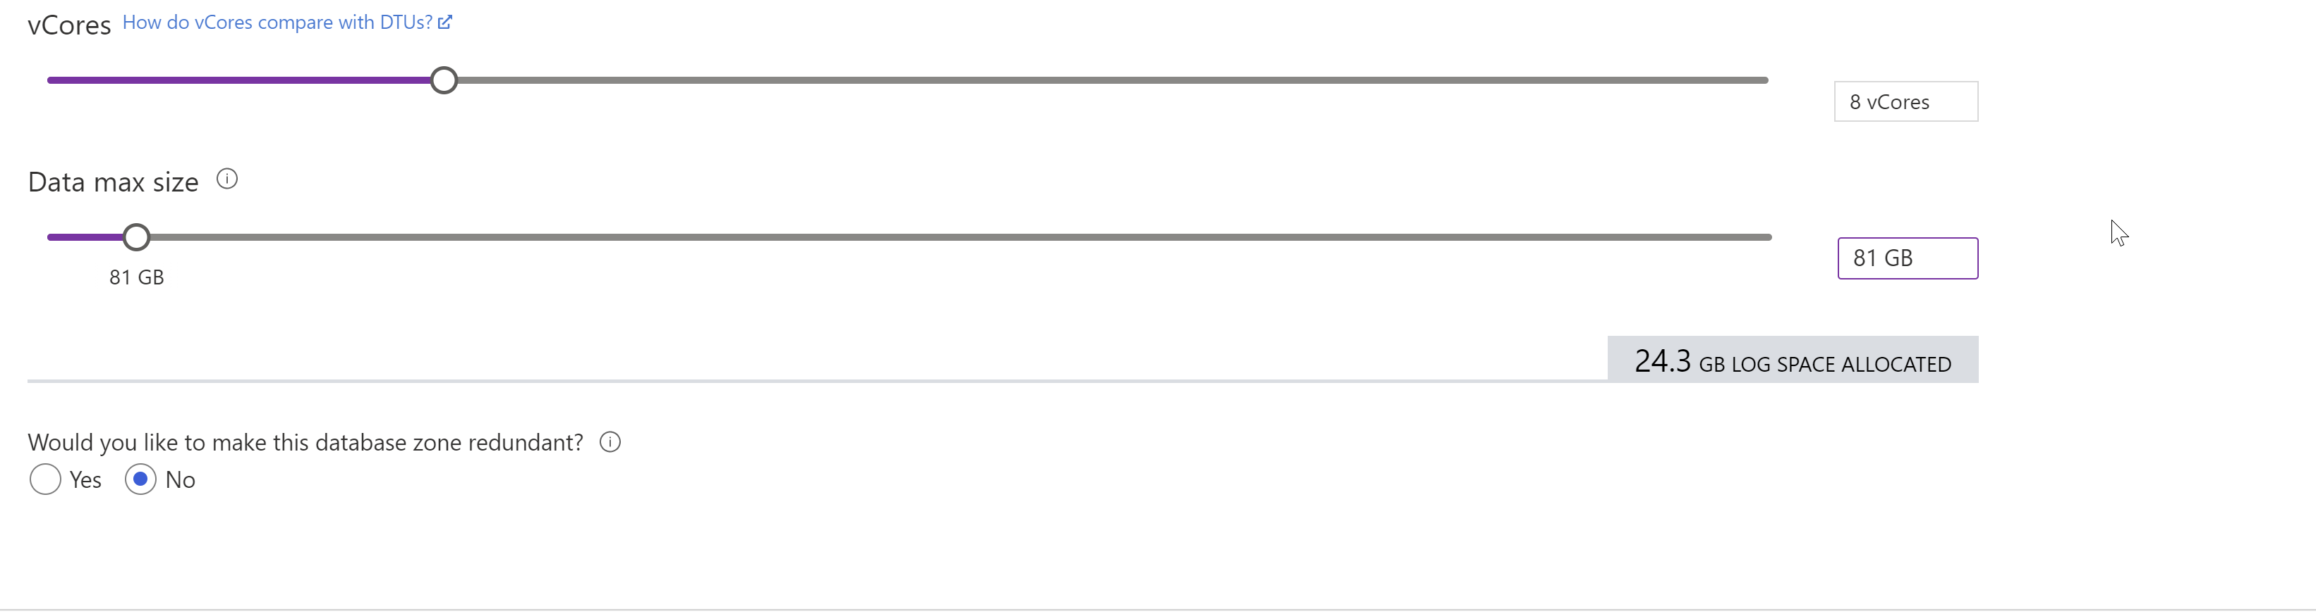
vCore

Slide 19
Service tiers
General purpose
- Most business uses
- low budget
- only one Primary
- No secondary standby
- Serverless
- Up to 80 vCores
- Up to 4TB
Business critical
- Read workloads like reporting
- In-Memory OLTP
- Includes readable secondaries
- Low latency
- High cost
- Up to 128 vCores
-Up to 4TB
Hyperscale
- Single Azure SQL databases only
- Storages up to 100TB
- Point in time restores
- 4 readable replicas
- Up to 80 vCores
Source: https://docs.microsoft.com/en-us/azure/azure-sql/database/service-tiers-general-purpose-business-critical

Slide 20
Compute tiers
Provisioned
- Fixed resources
- Be charged regardless of these resource usage
Serverless
- Intermittent and unpredictable workloads
- Automatic compute scaling
- Min and max vCores
- Billed only for the resources used
- Automatic pausing when not used
- Pay only for storage

Slide 21
How to create Azure SQL Database?

Slide 22
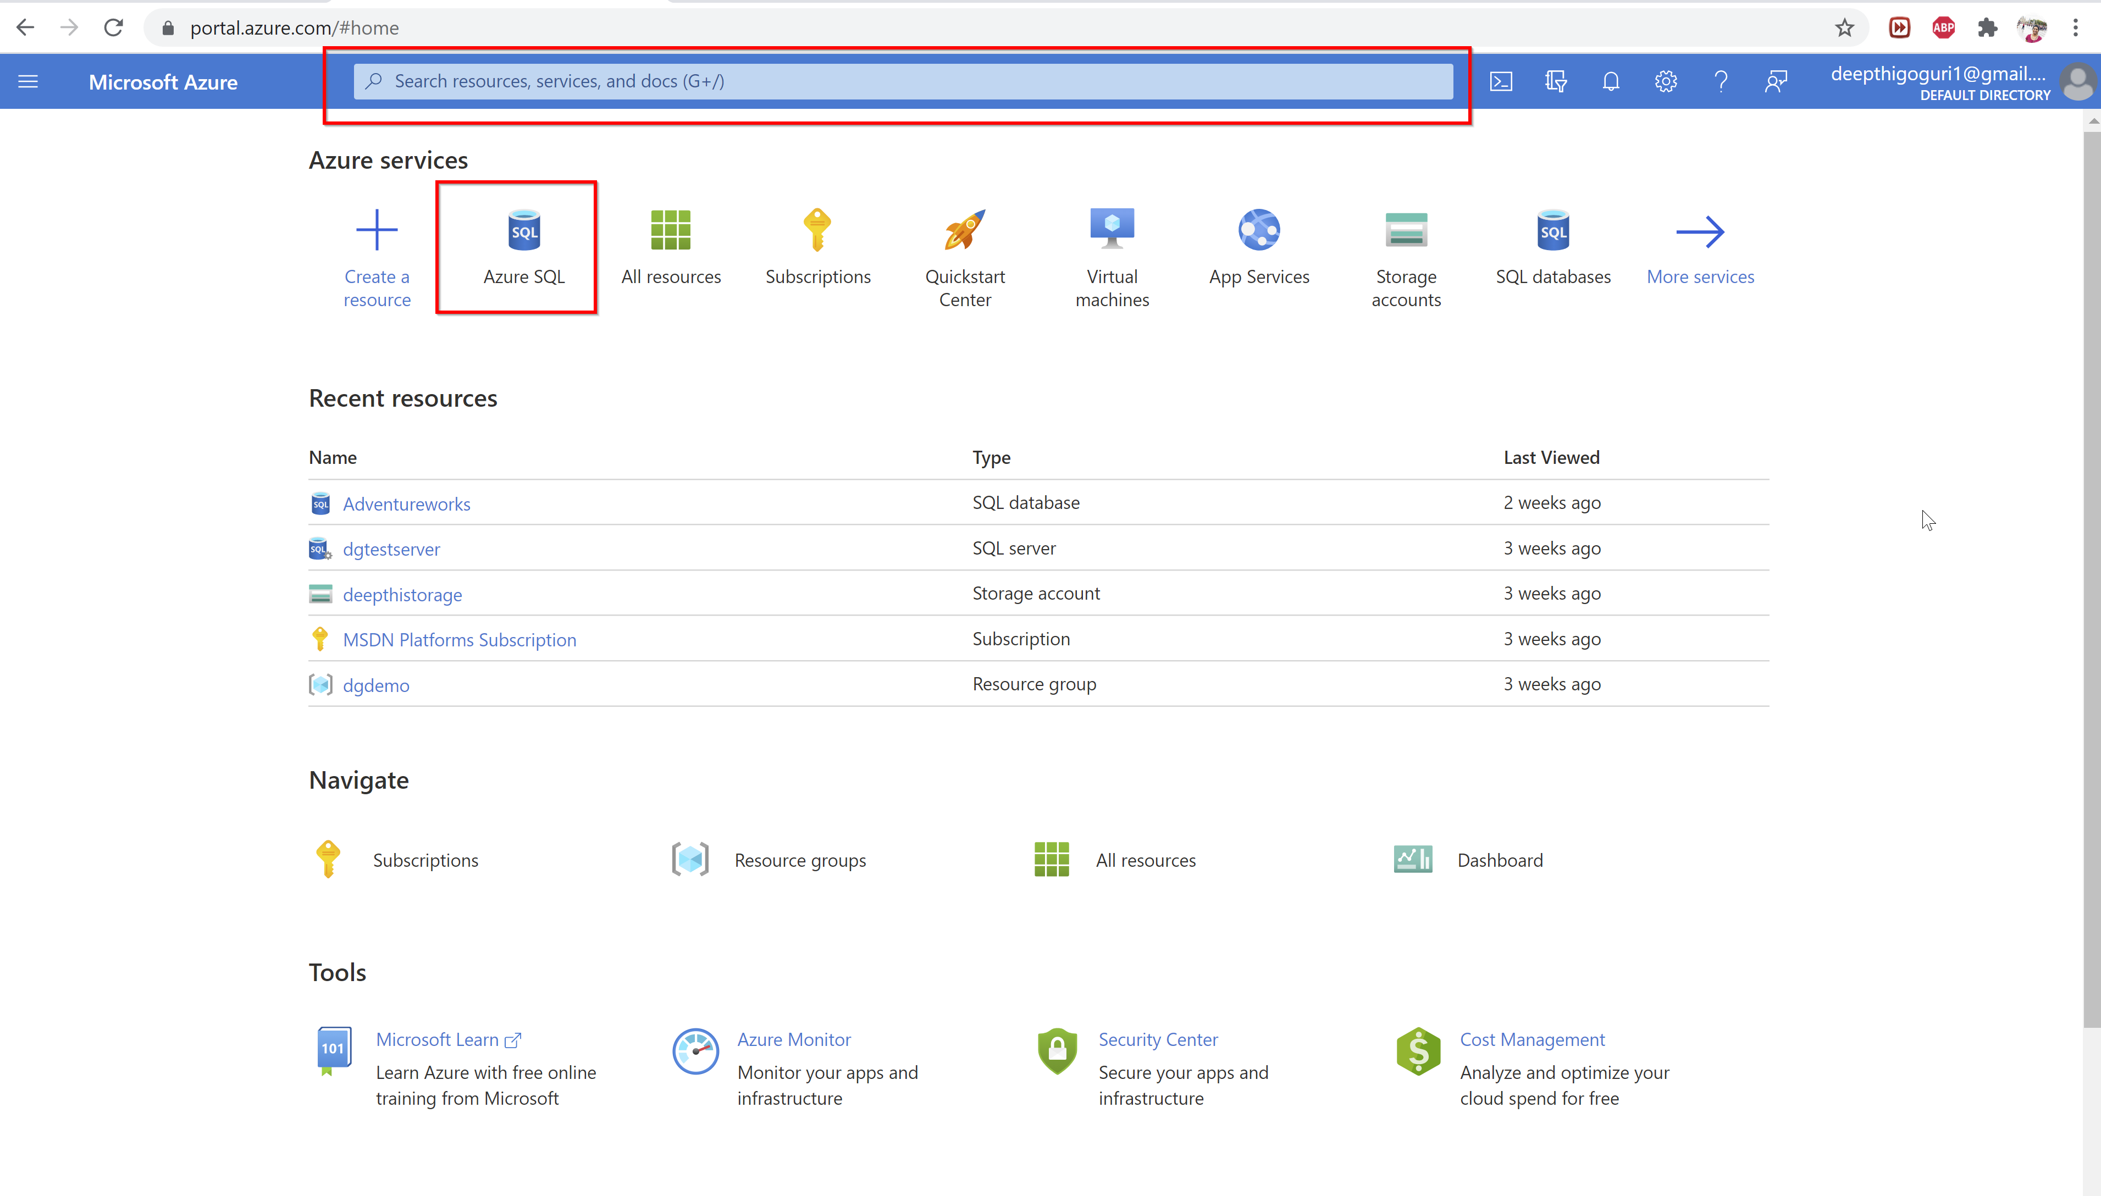

Slide 23
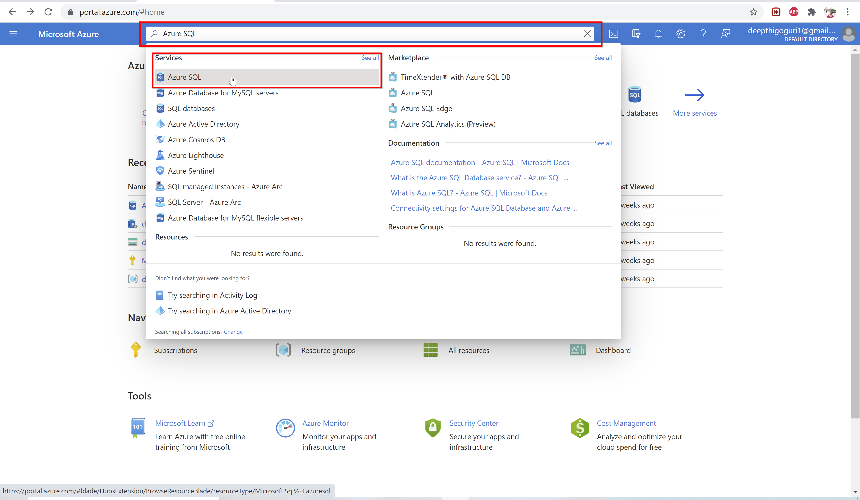

Slide 24
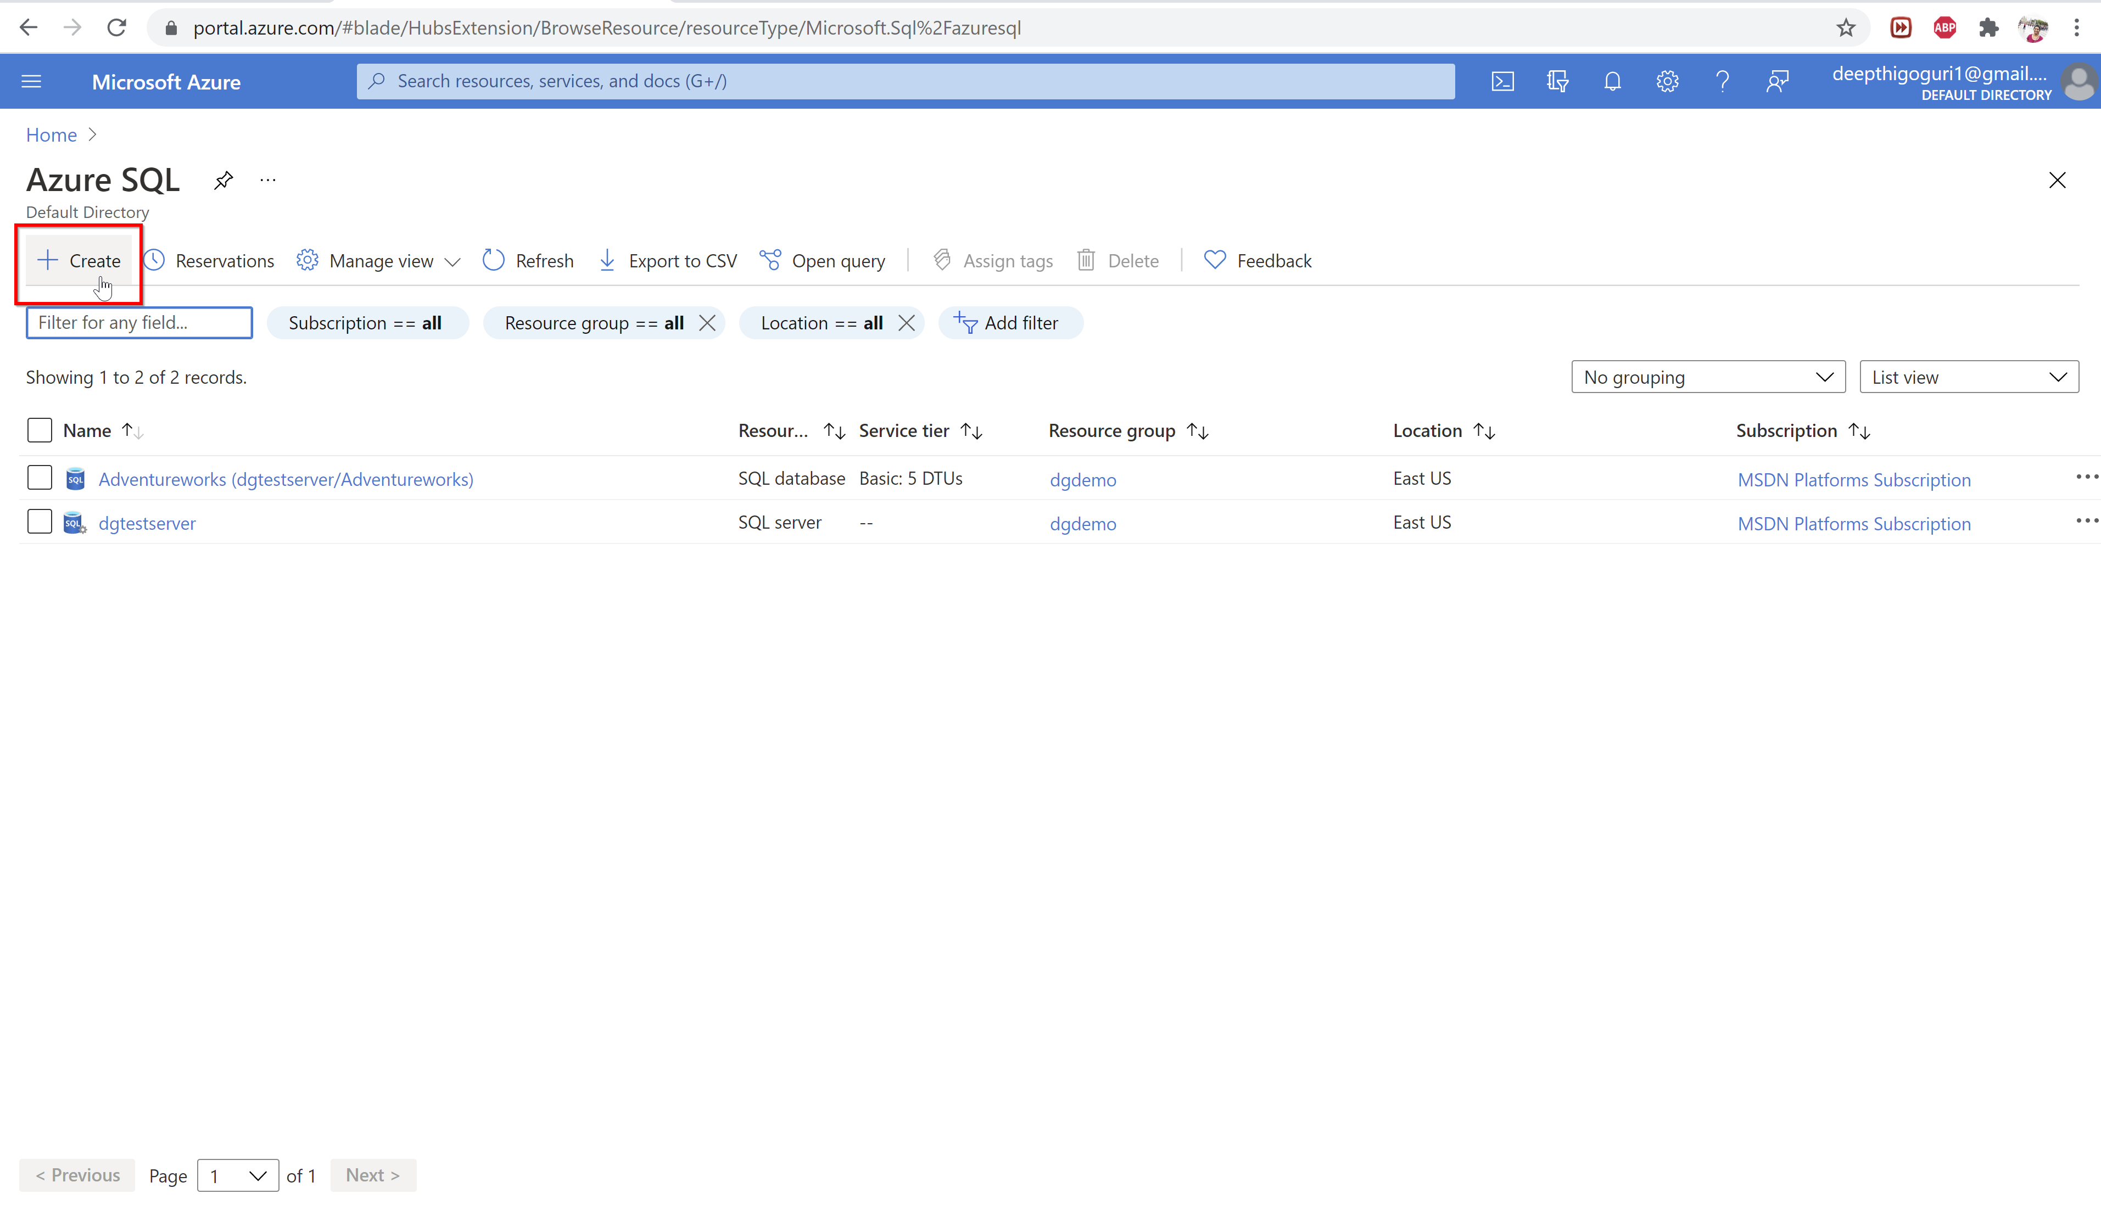

Slide 25
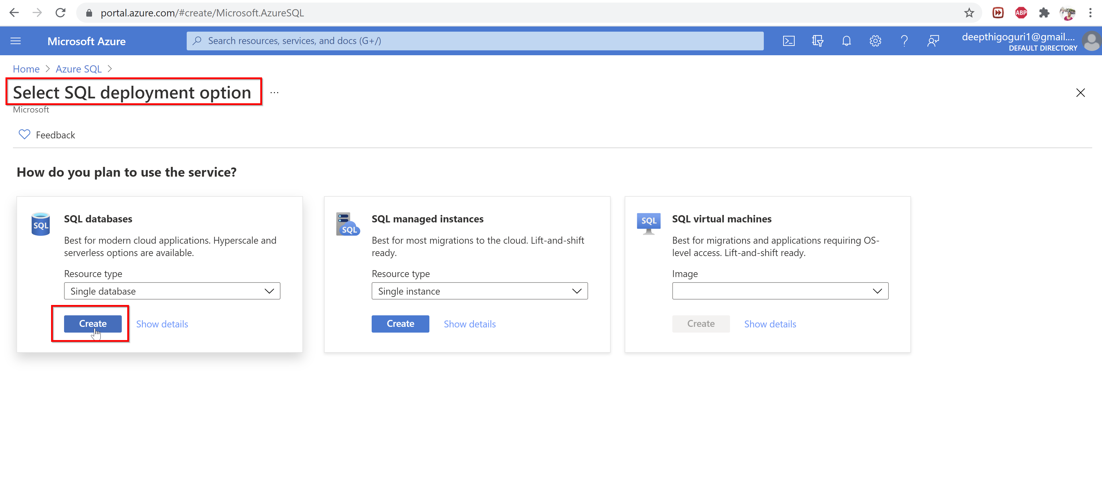

Slide 26
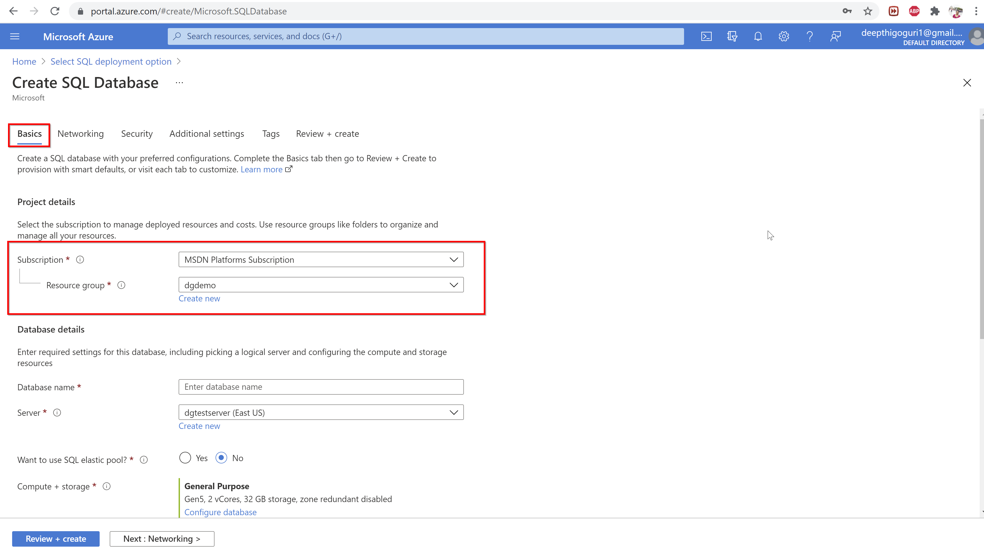

Slide 27
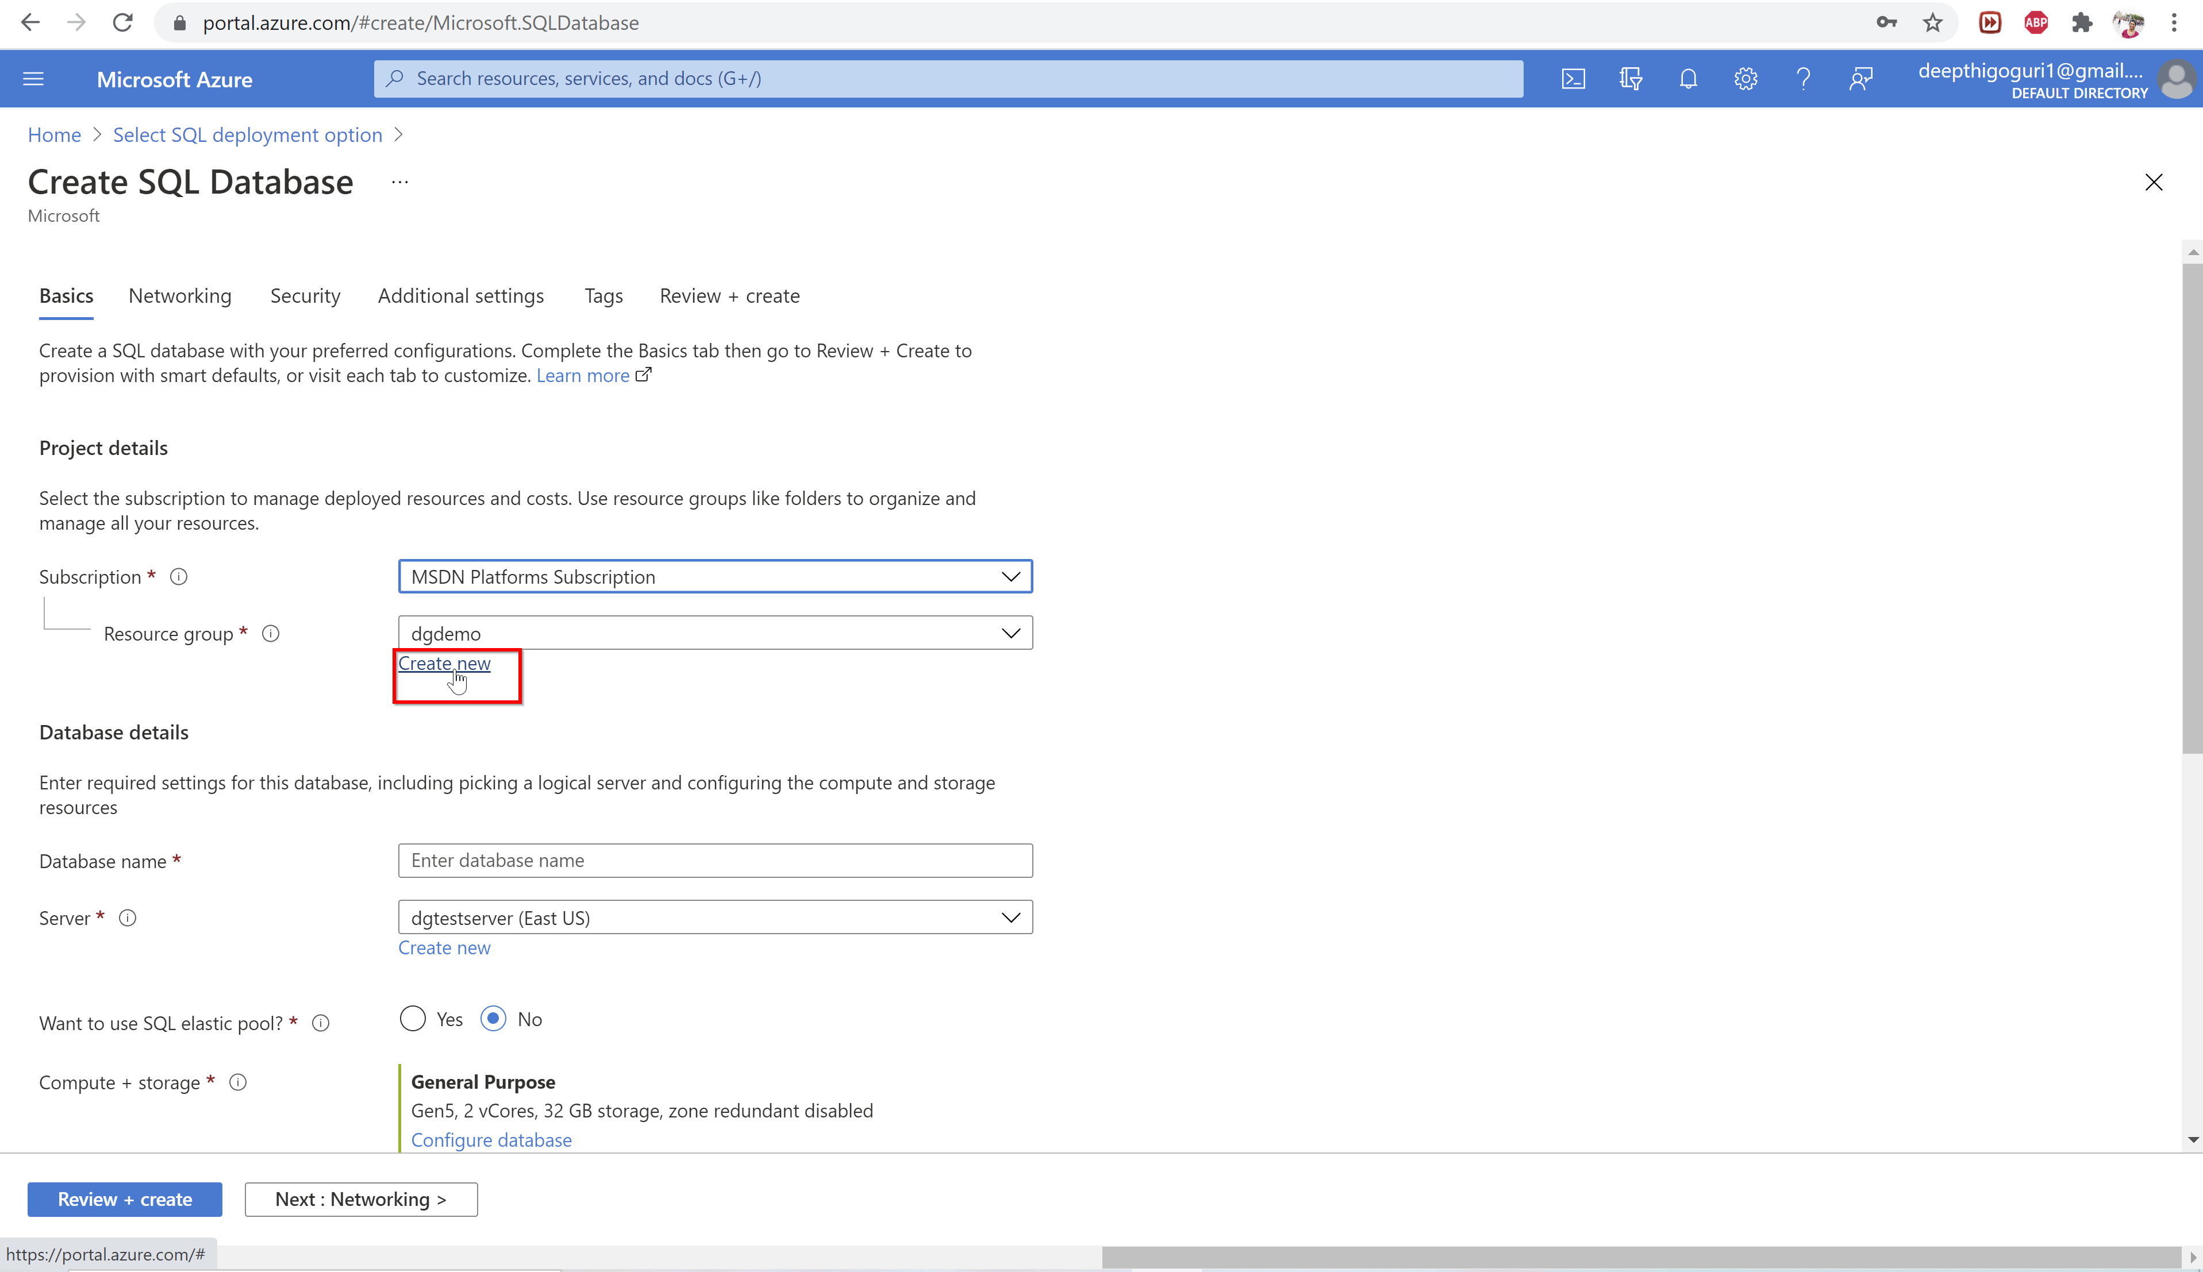

Slide 28
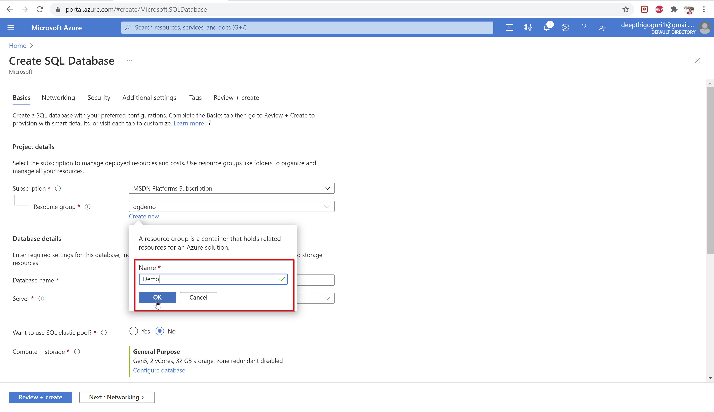

Slide 29
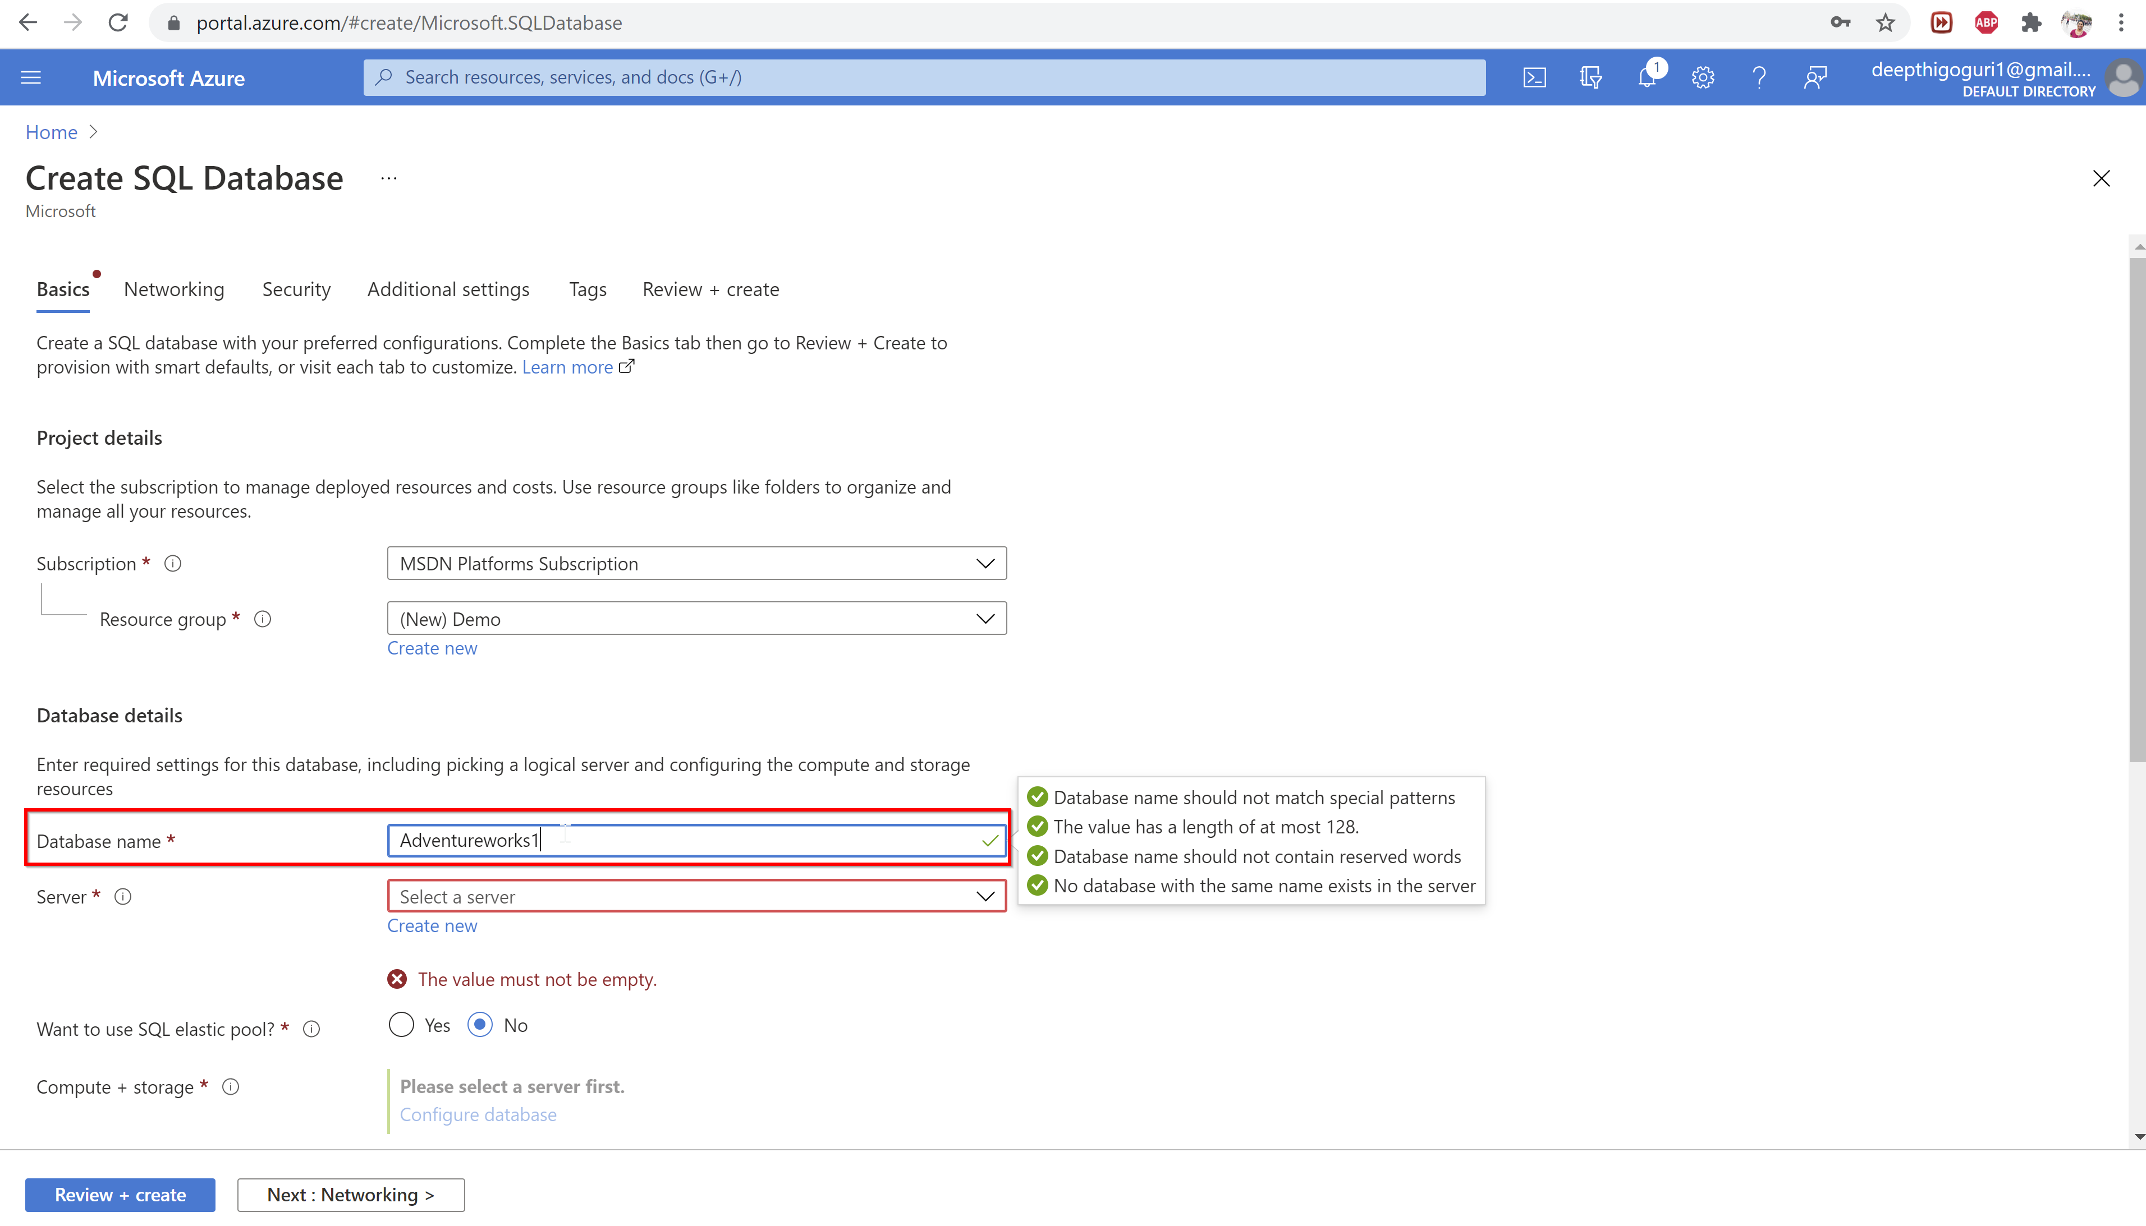

Slide 30
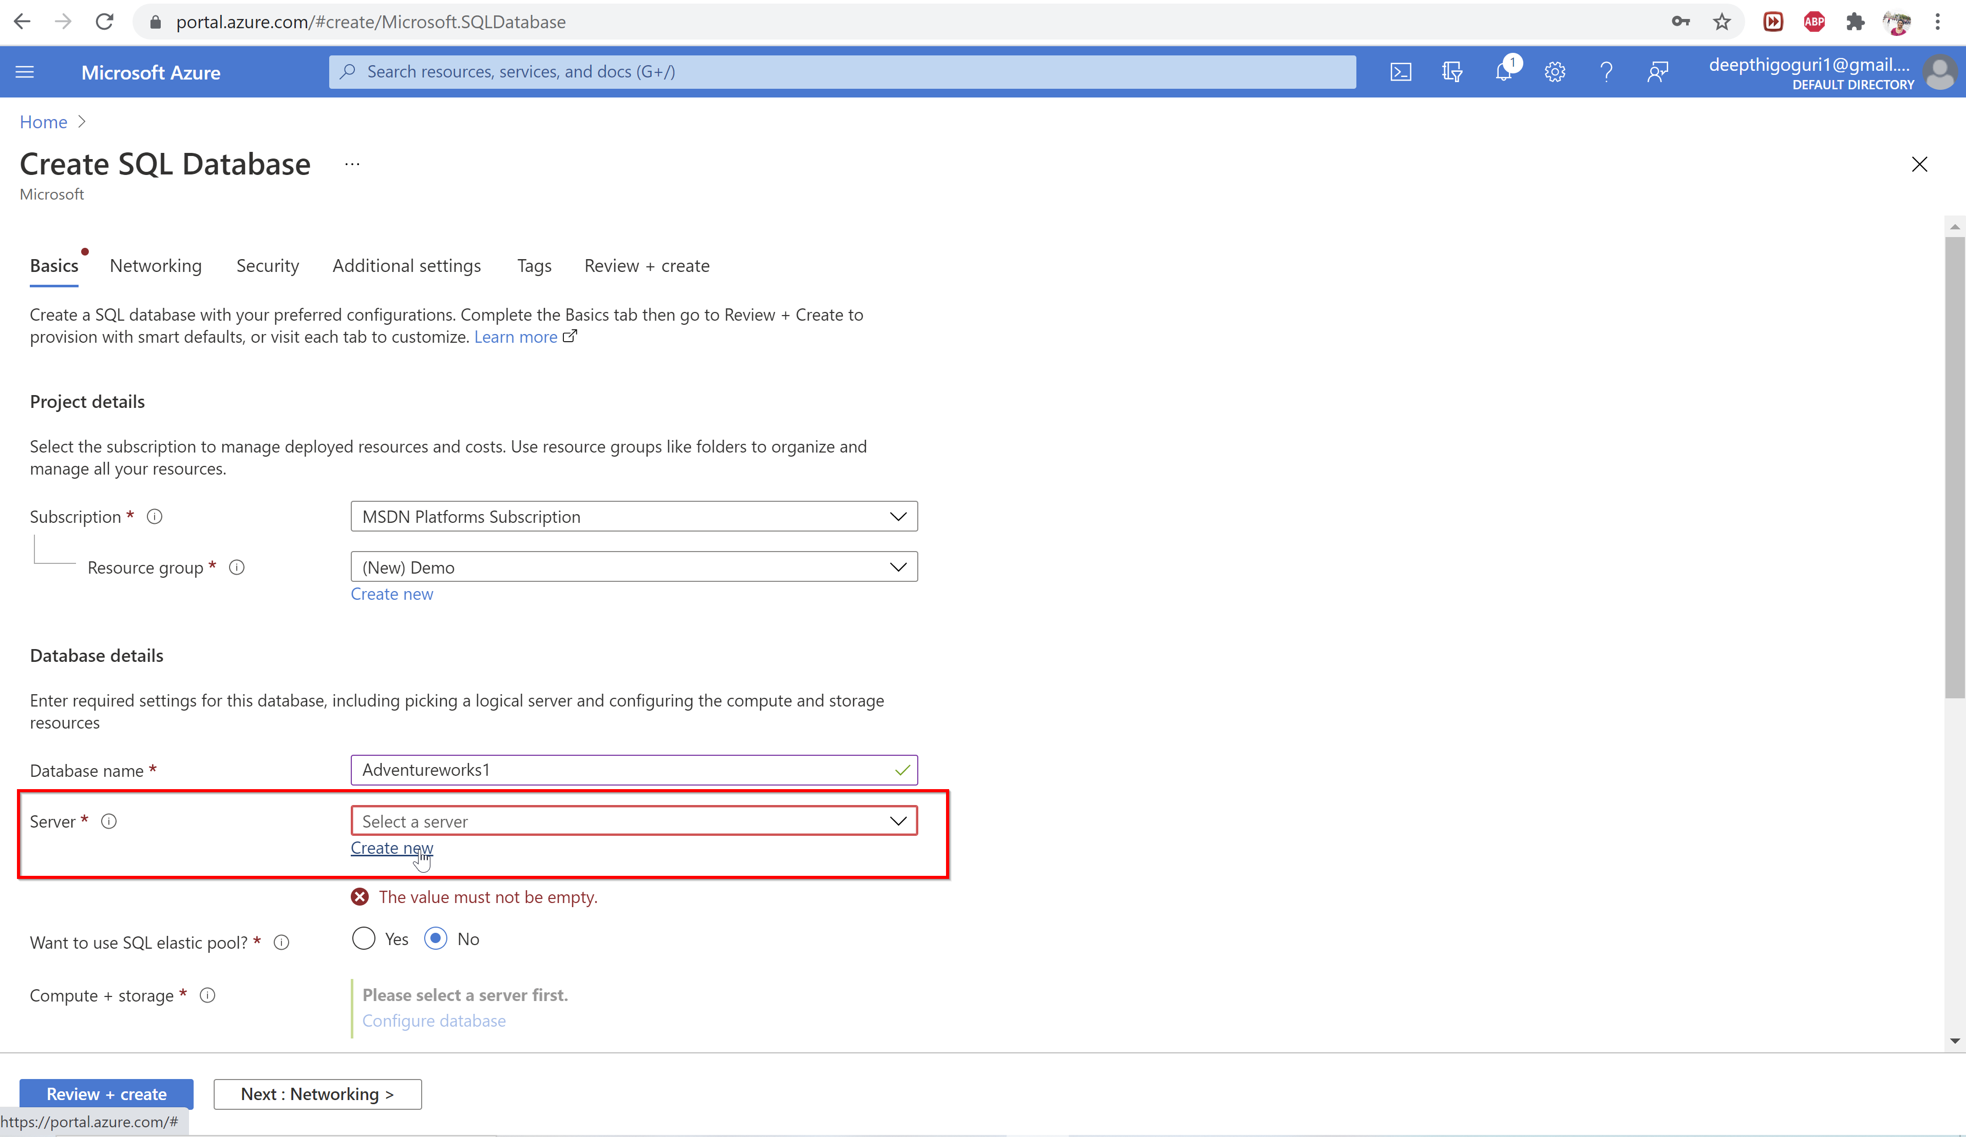

Slide 31
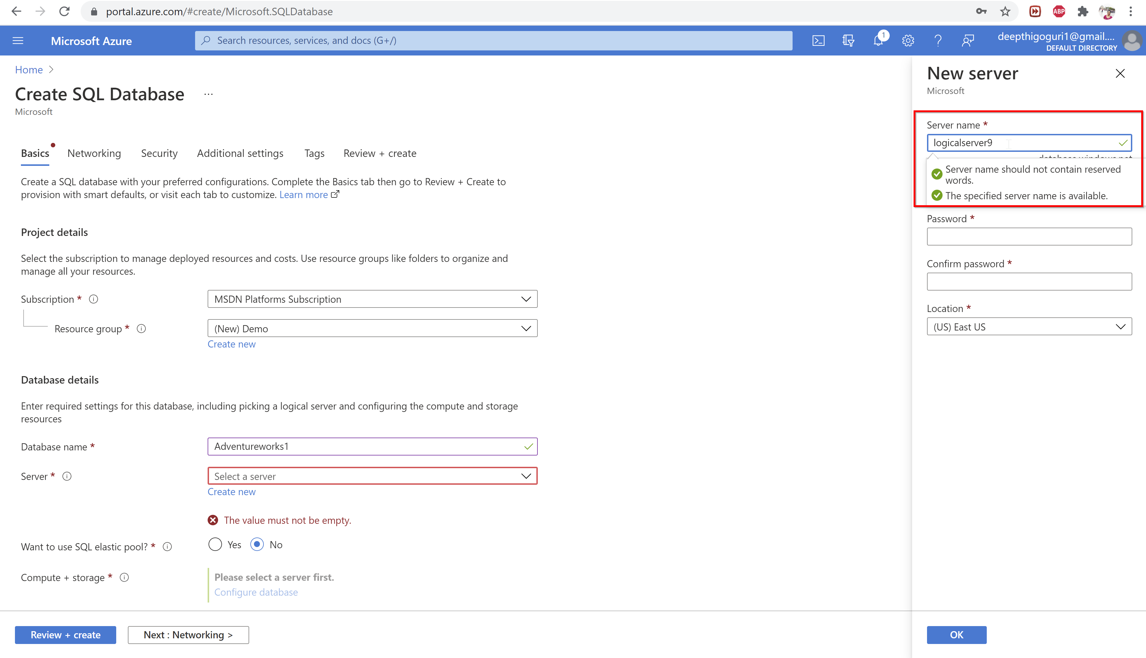

Slide 32
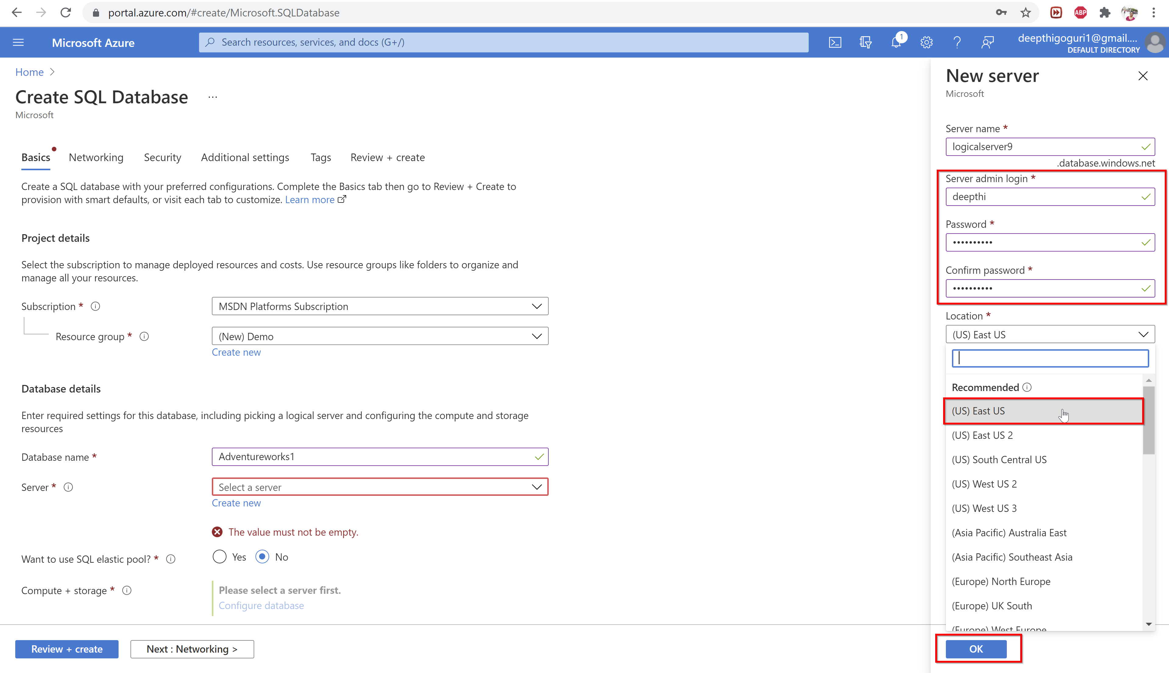

Slide 33
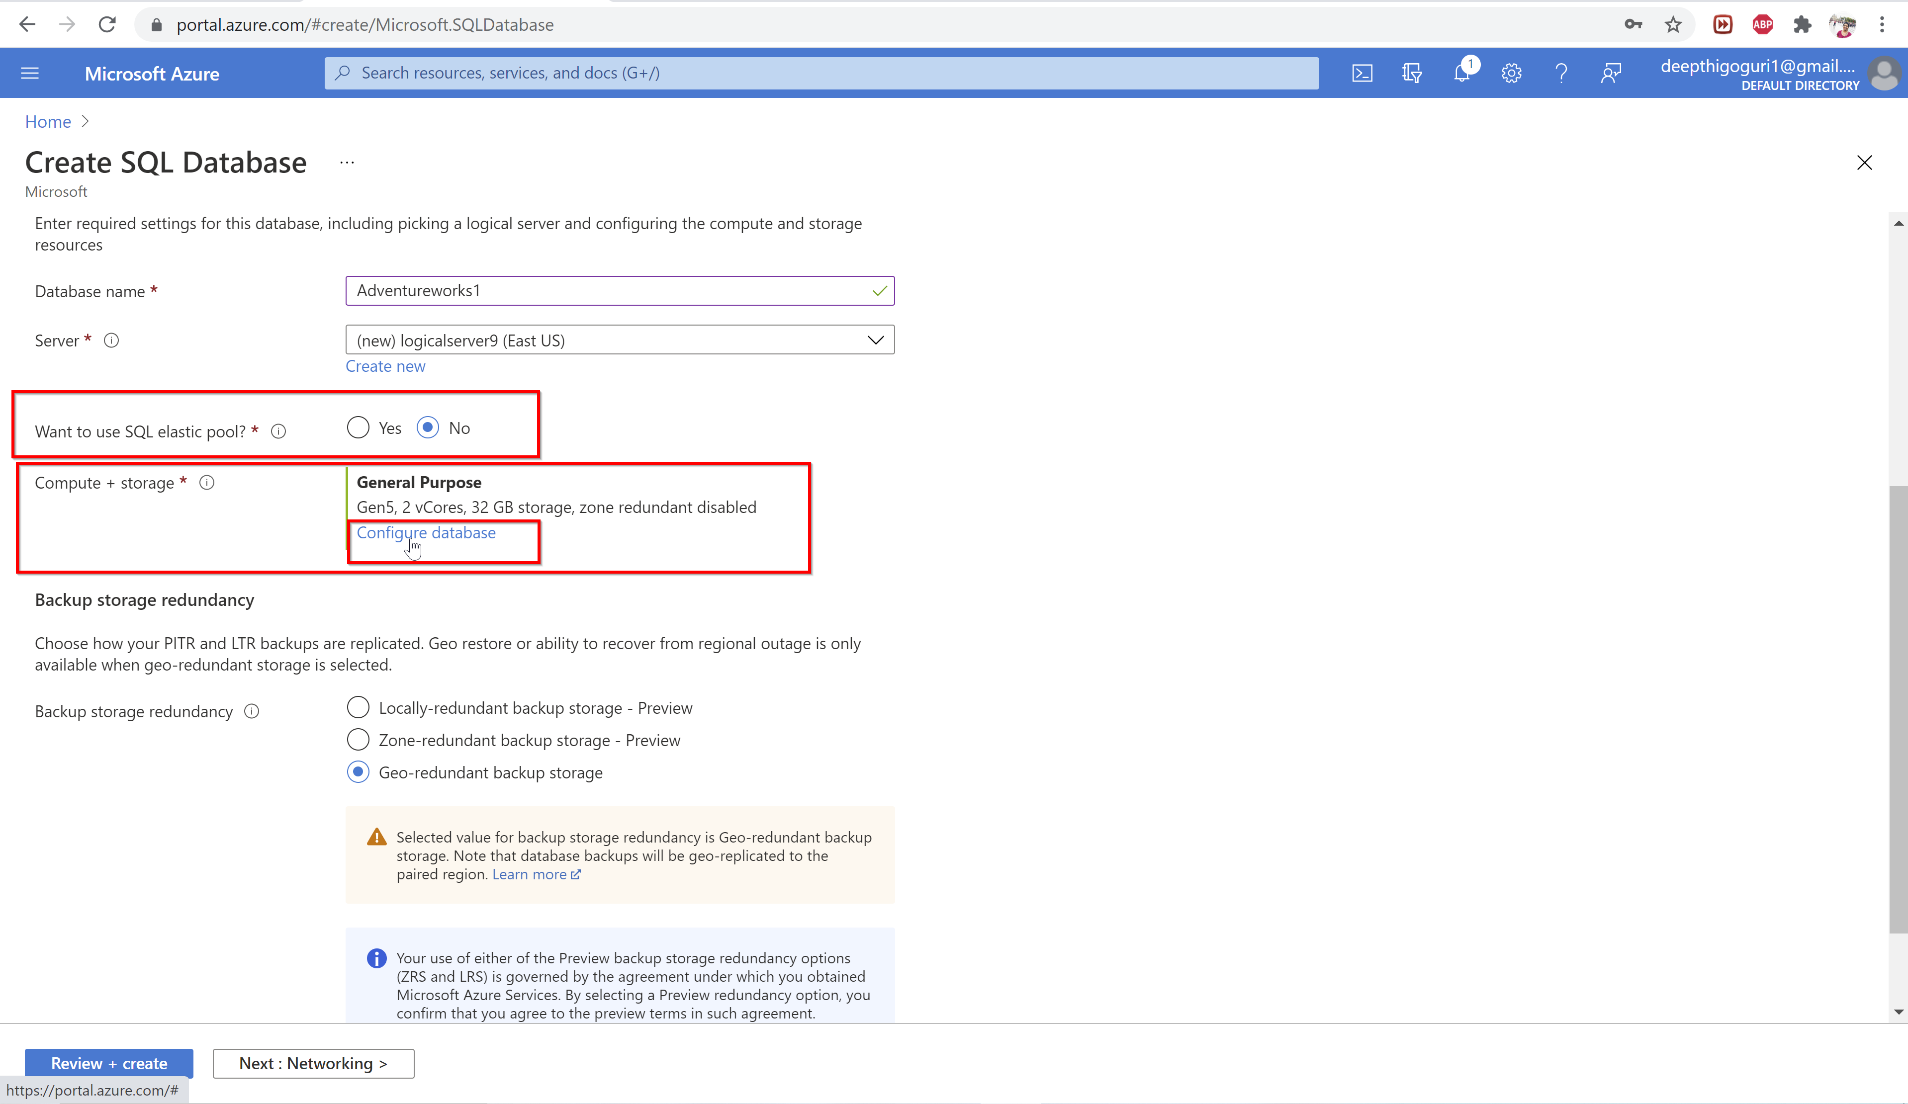

Slide 34
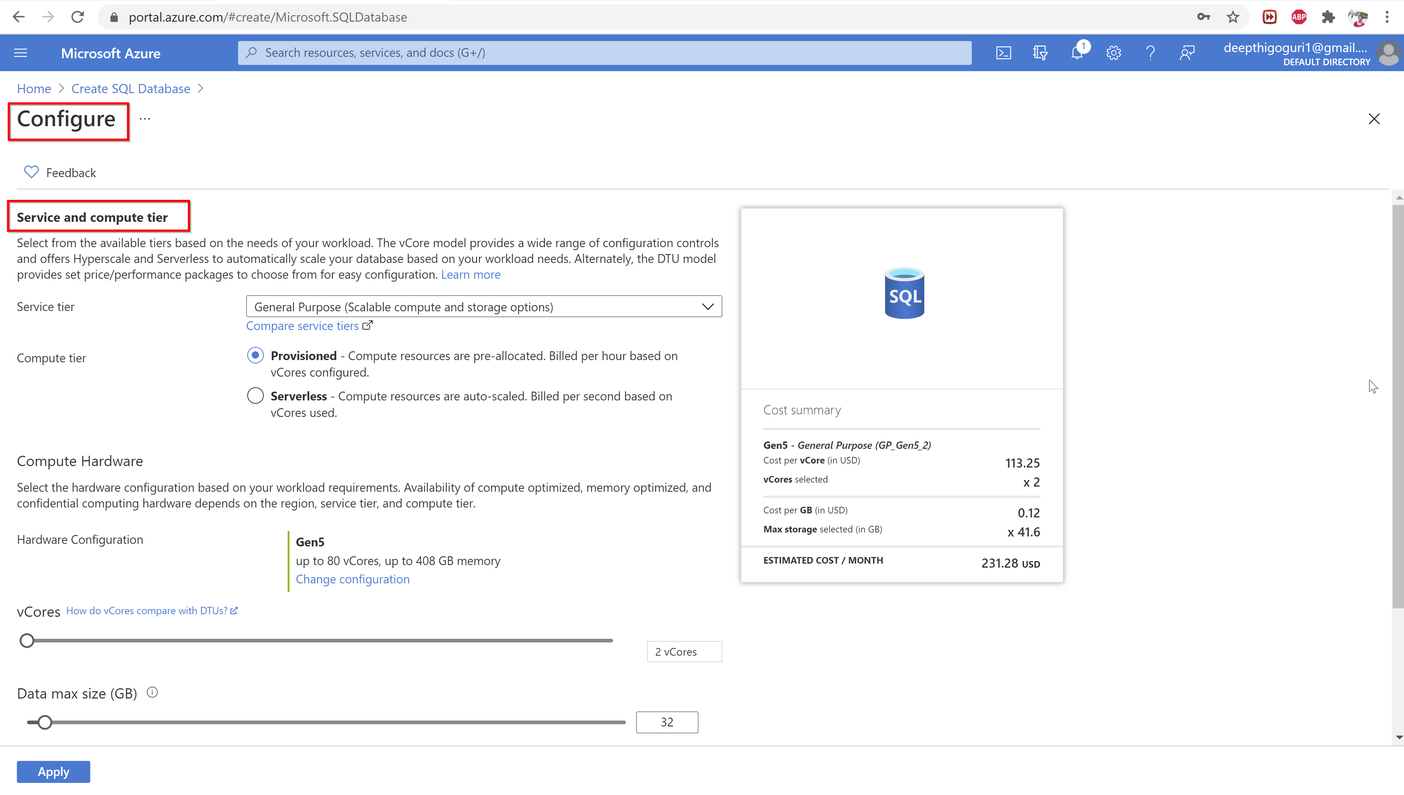

Slide 35
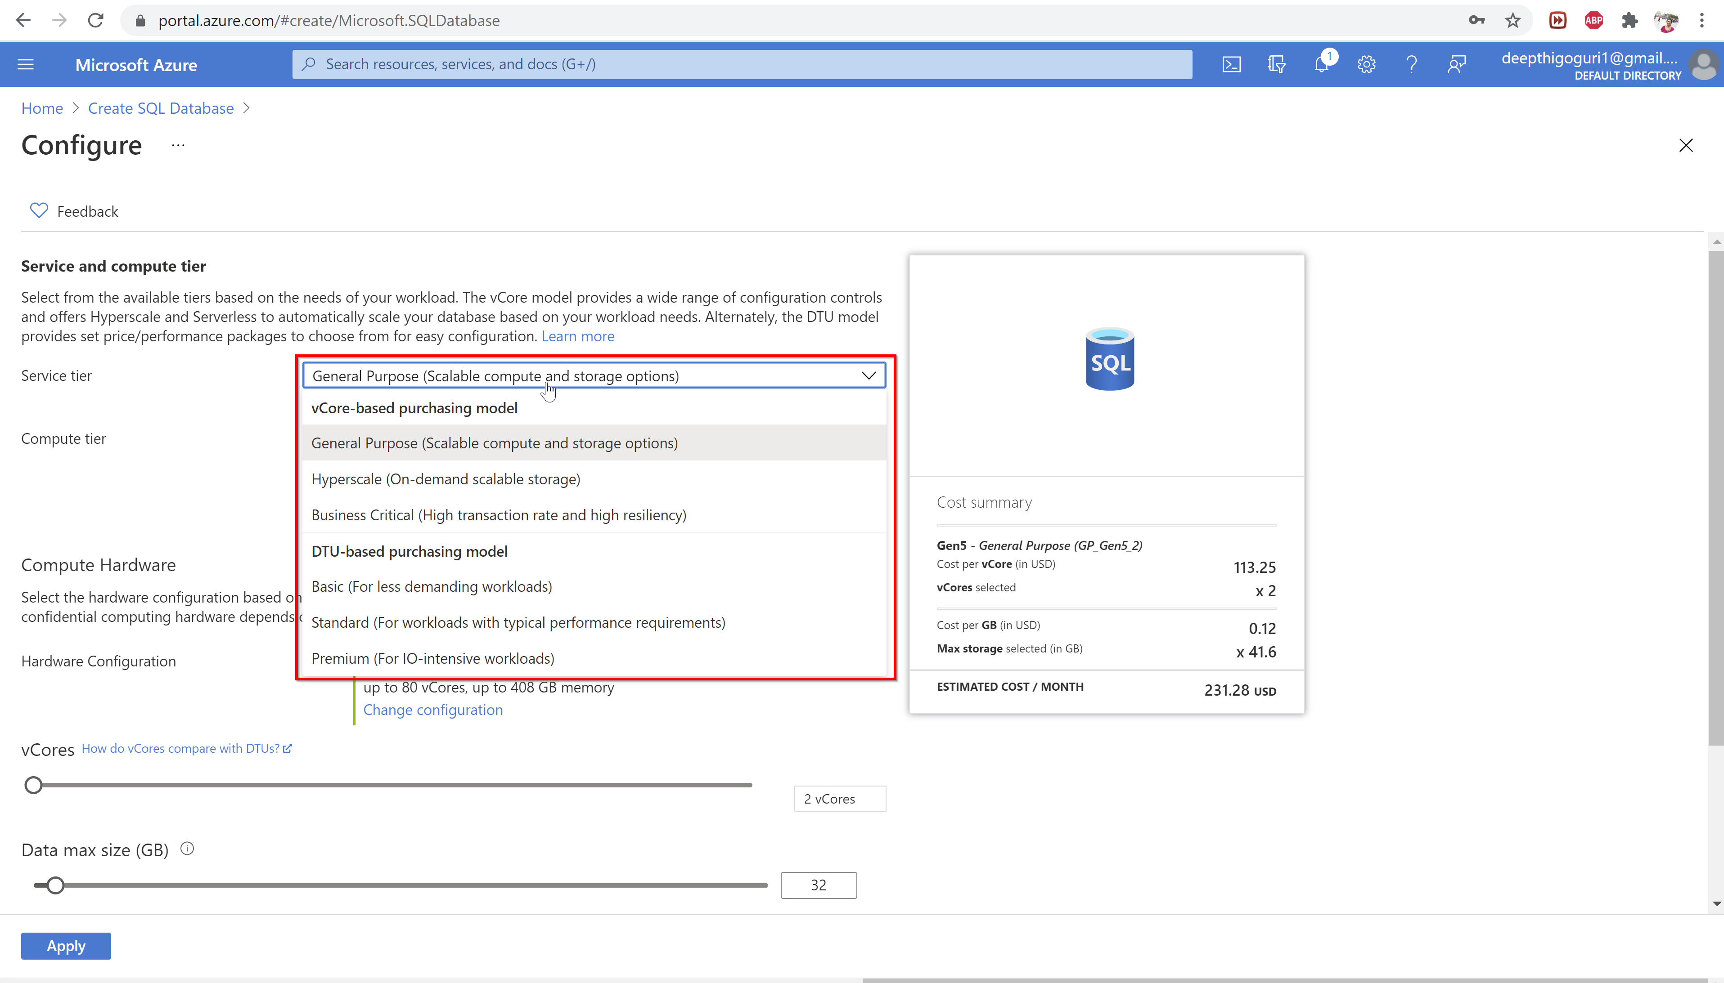

Slide 36
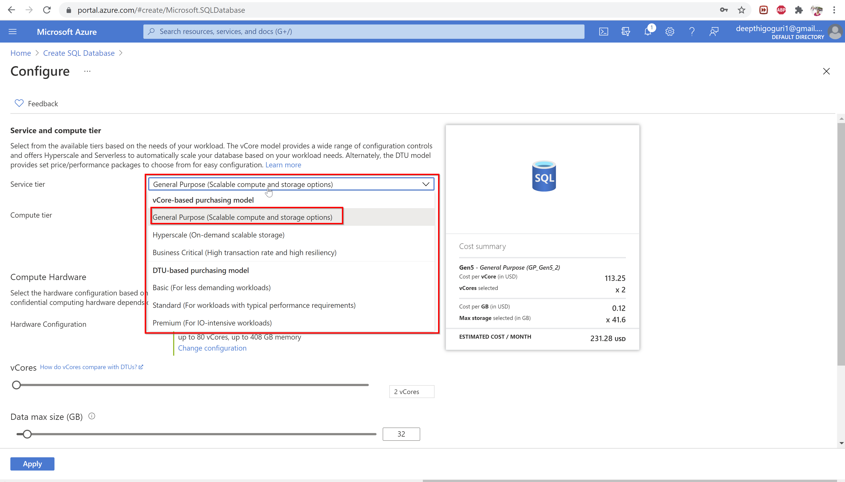

Slide 37
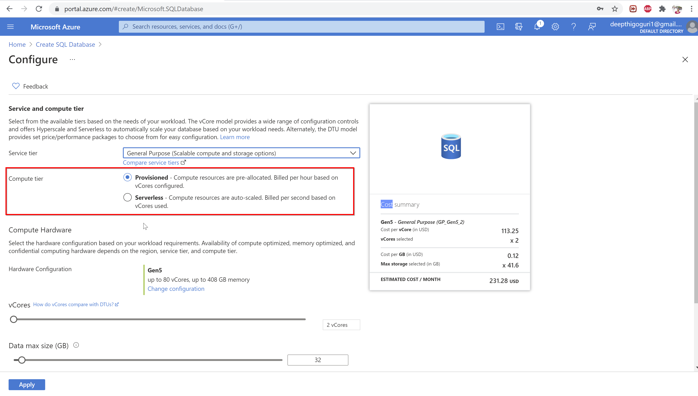

Slide 38
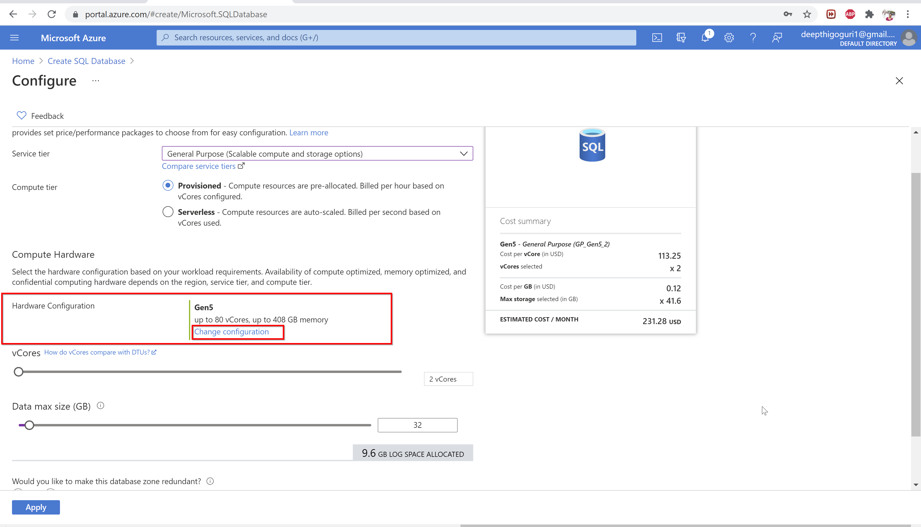

Slide 39
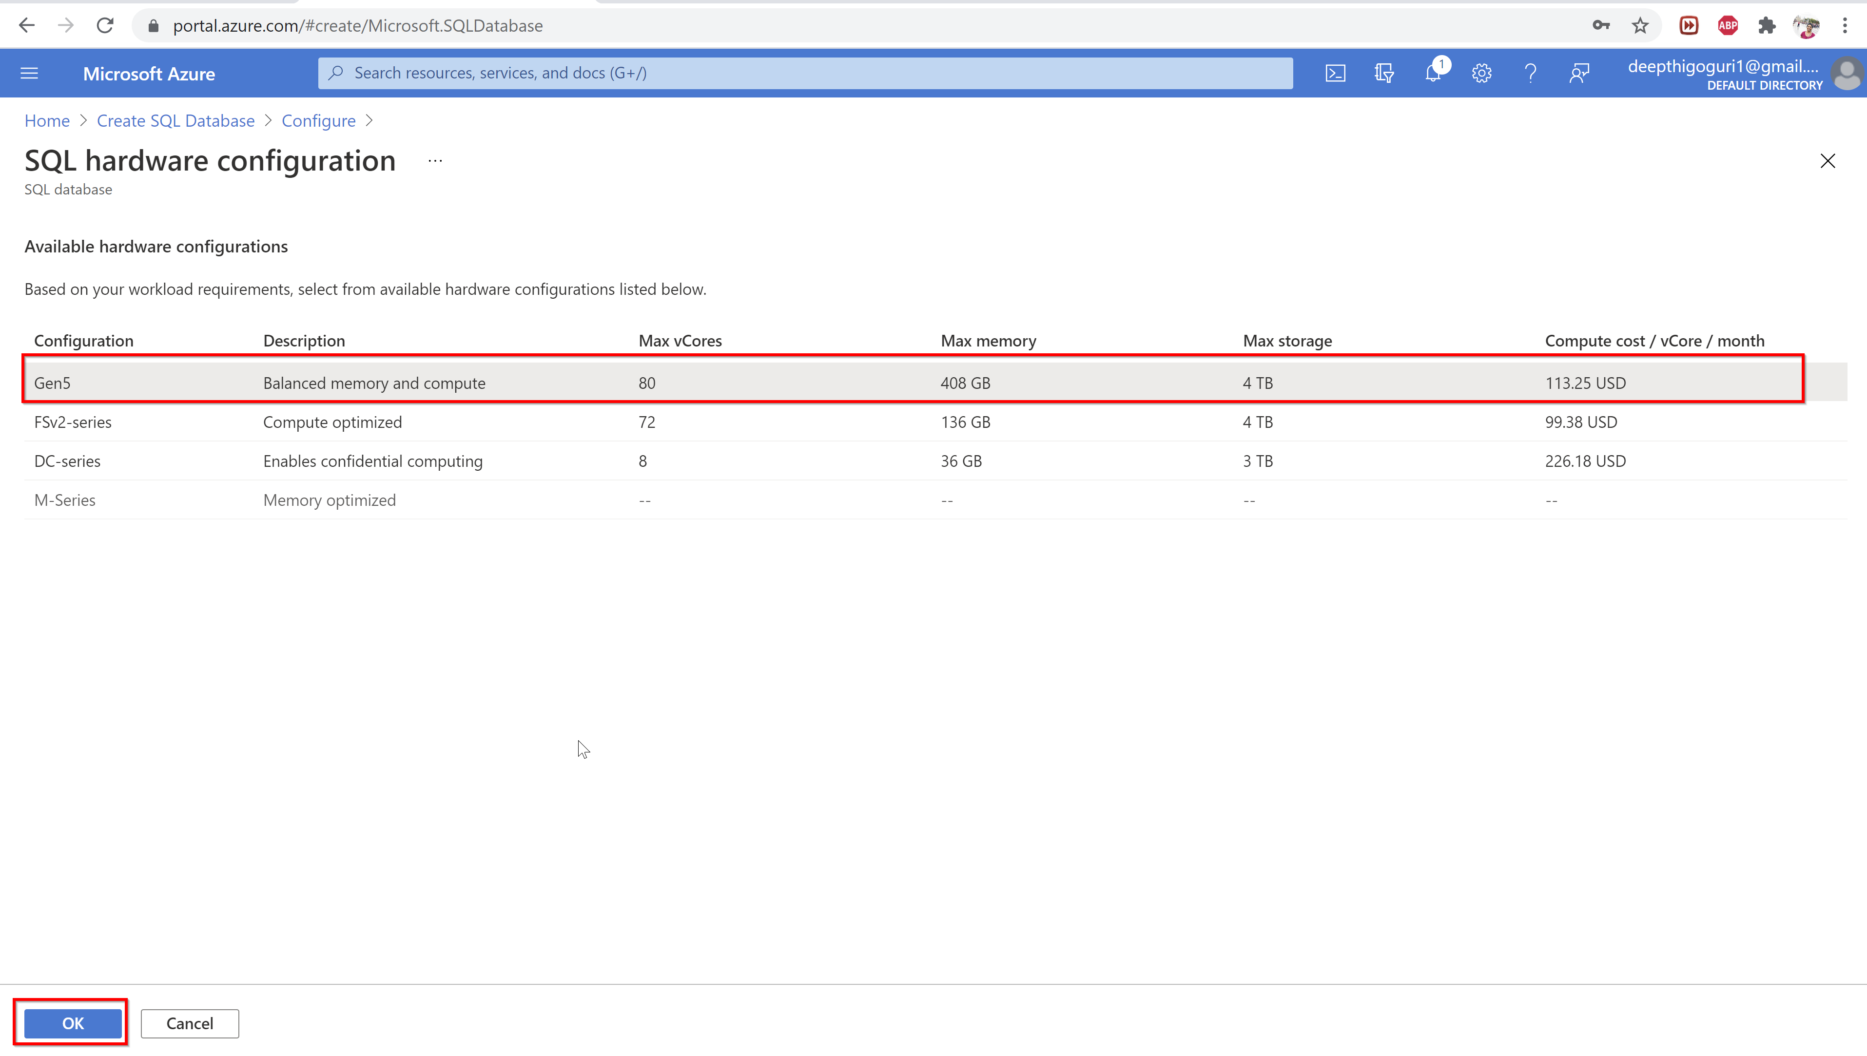

Slide 40
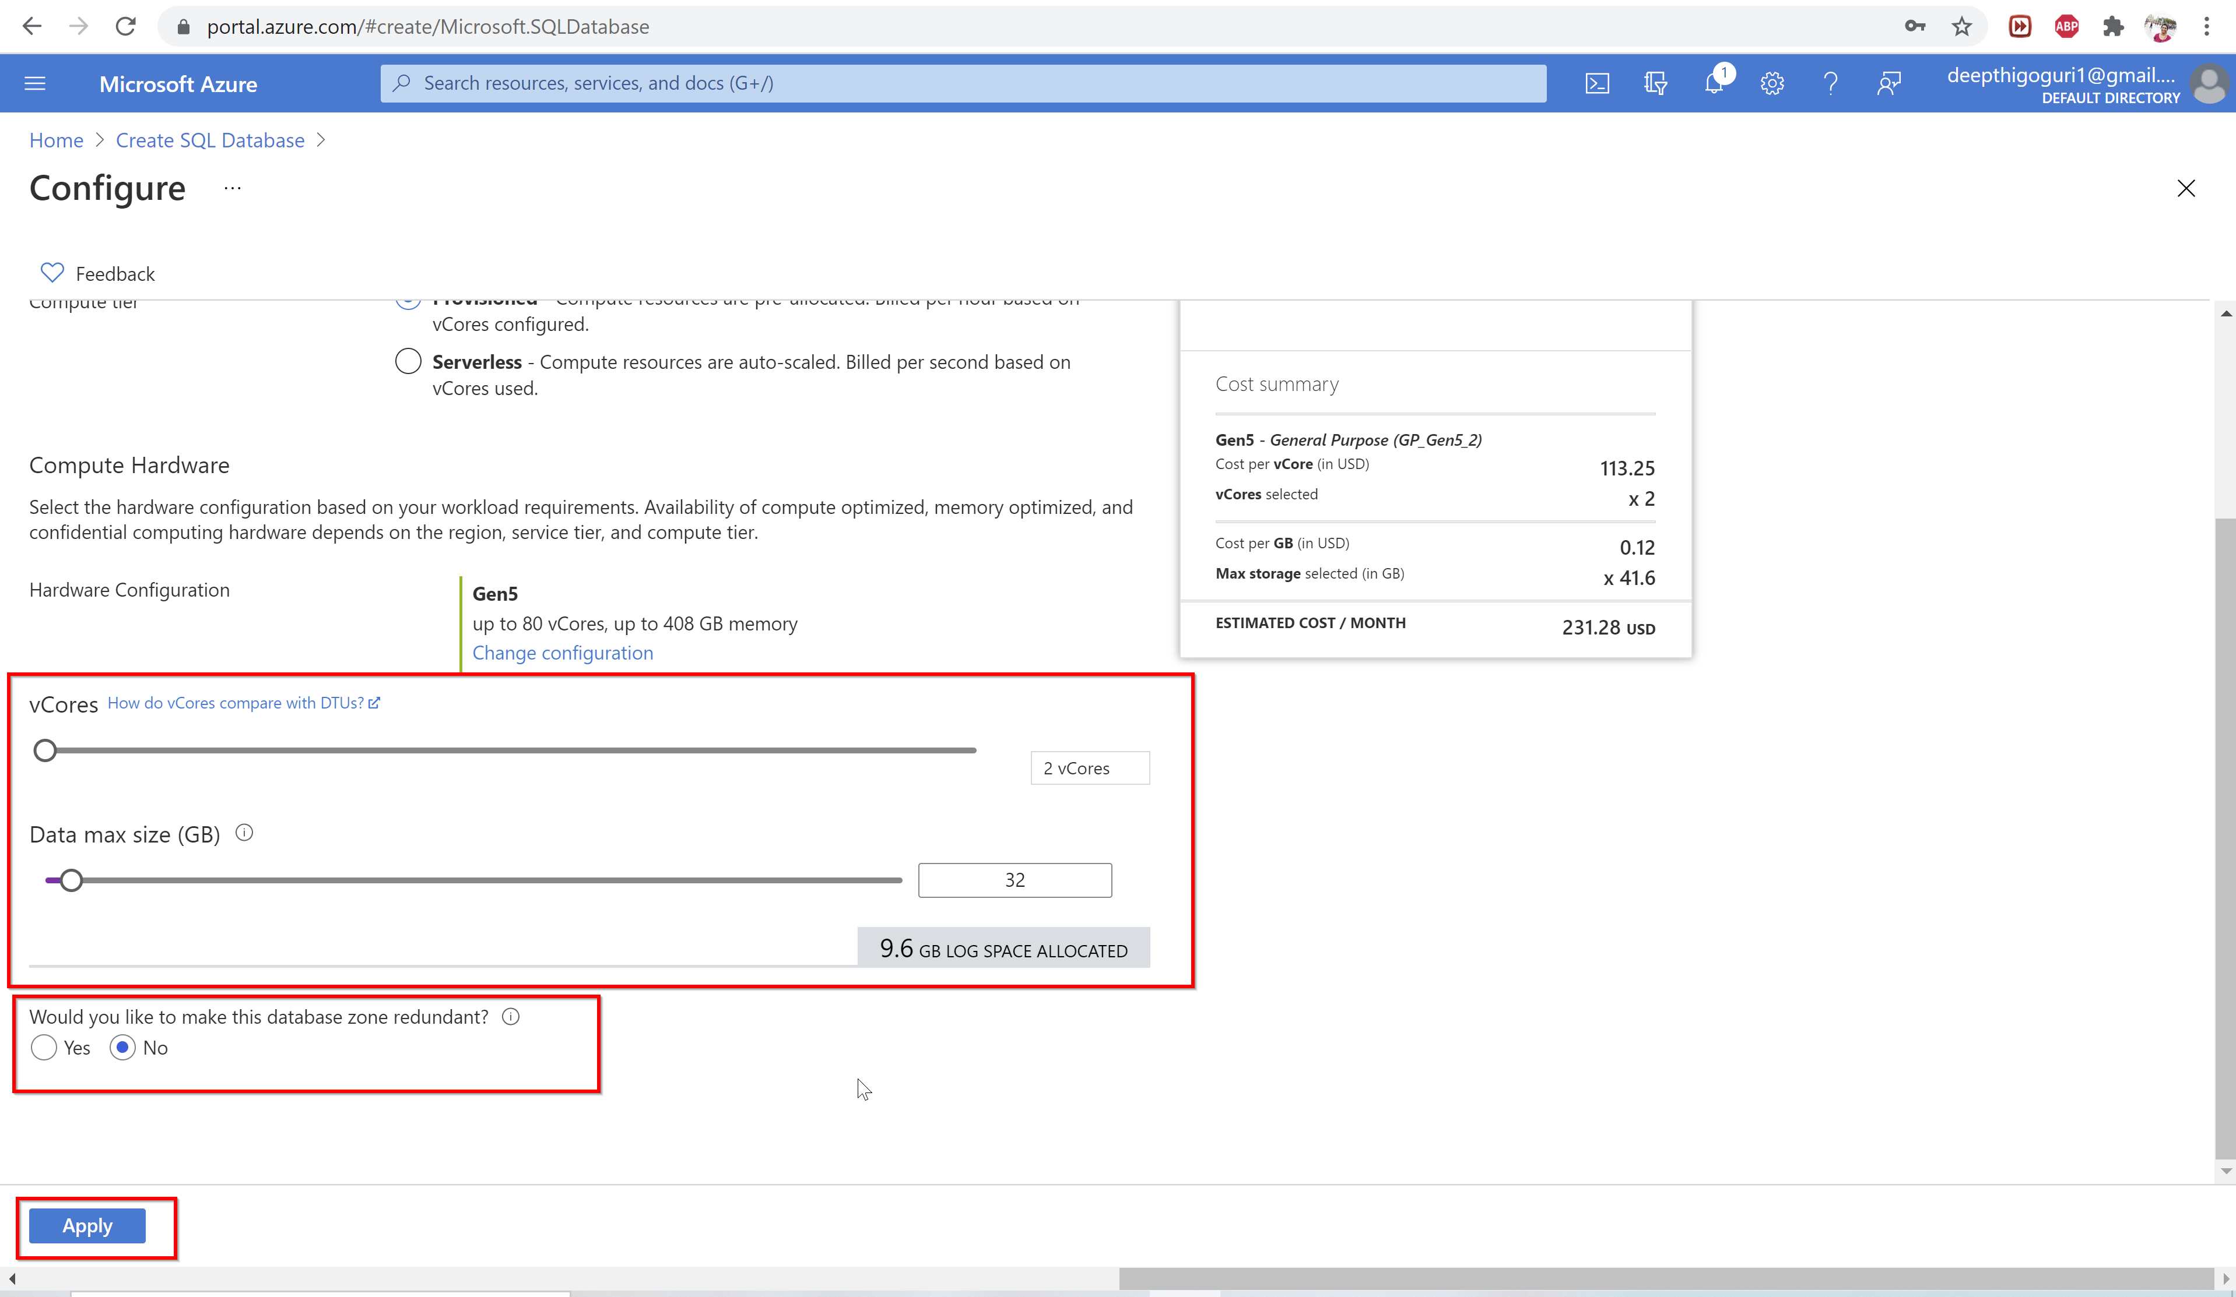

Slide 41
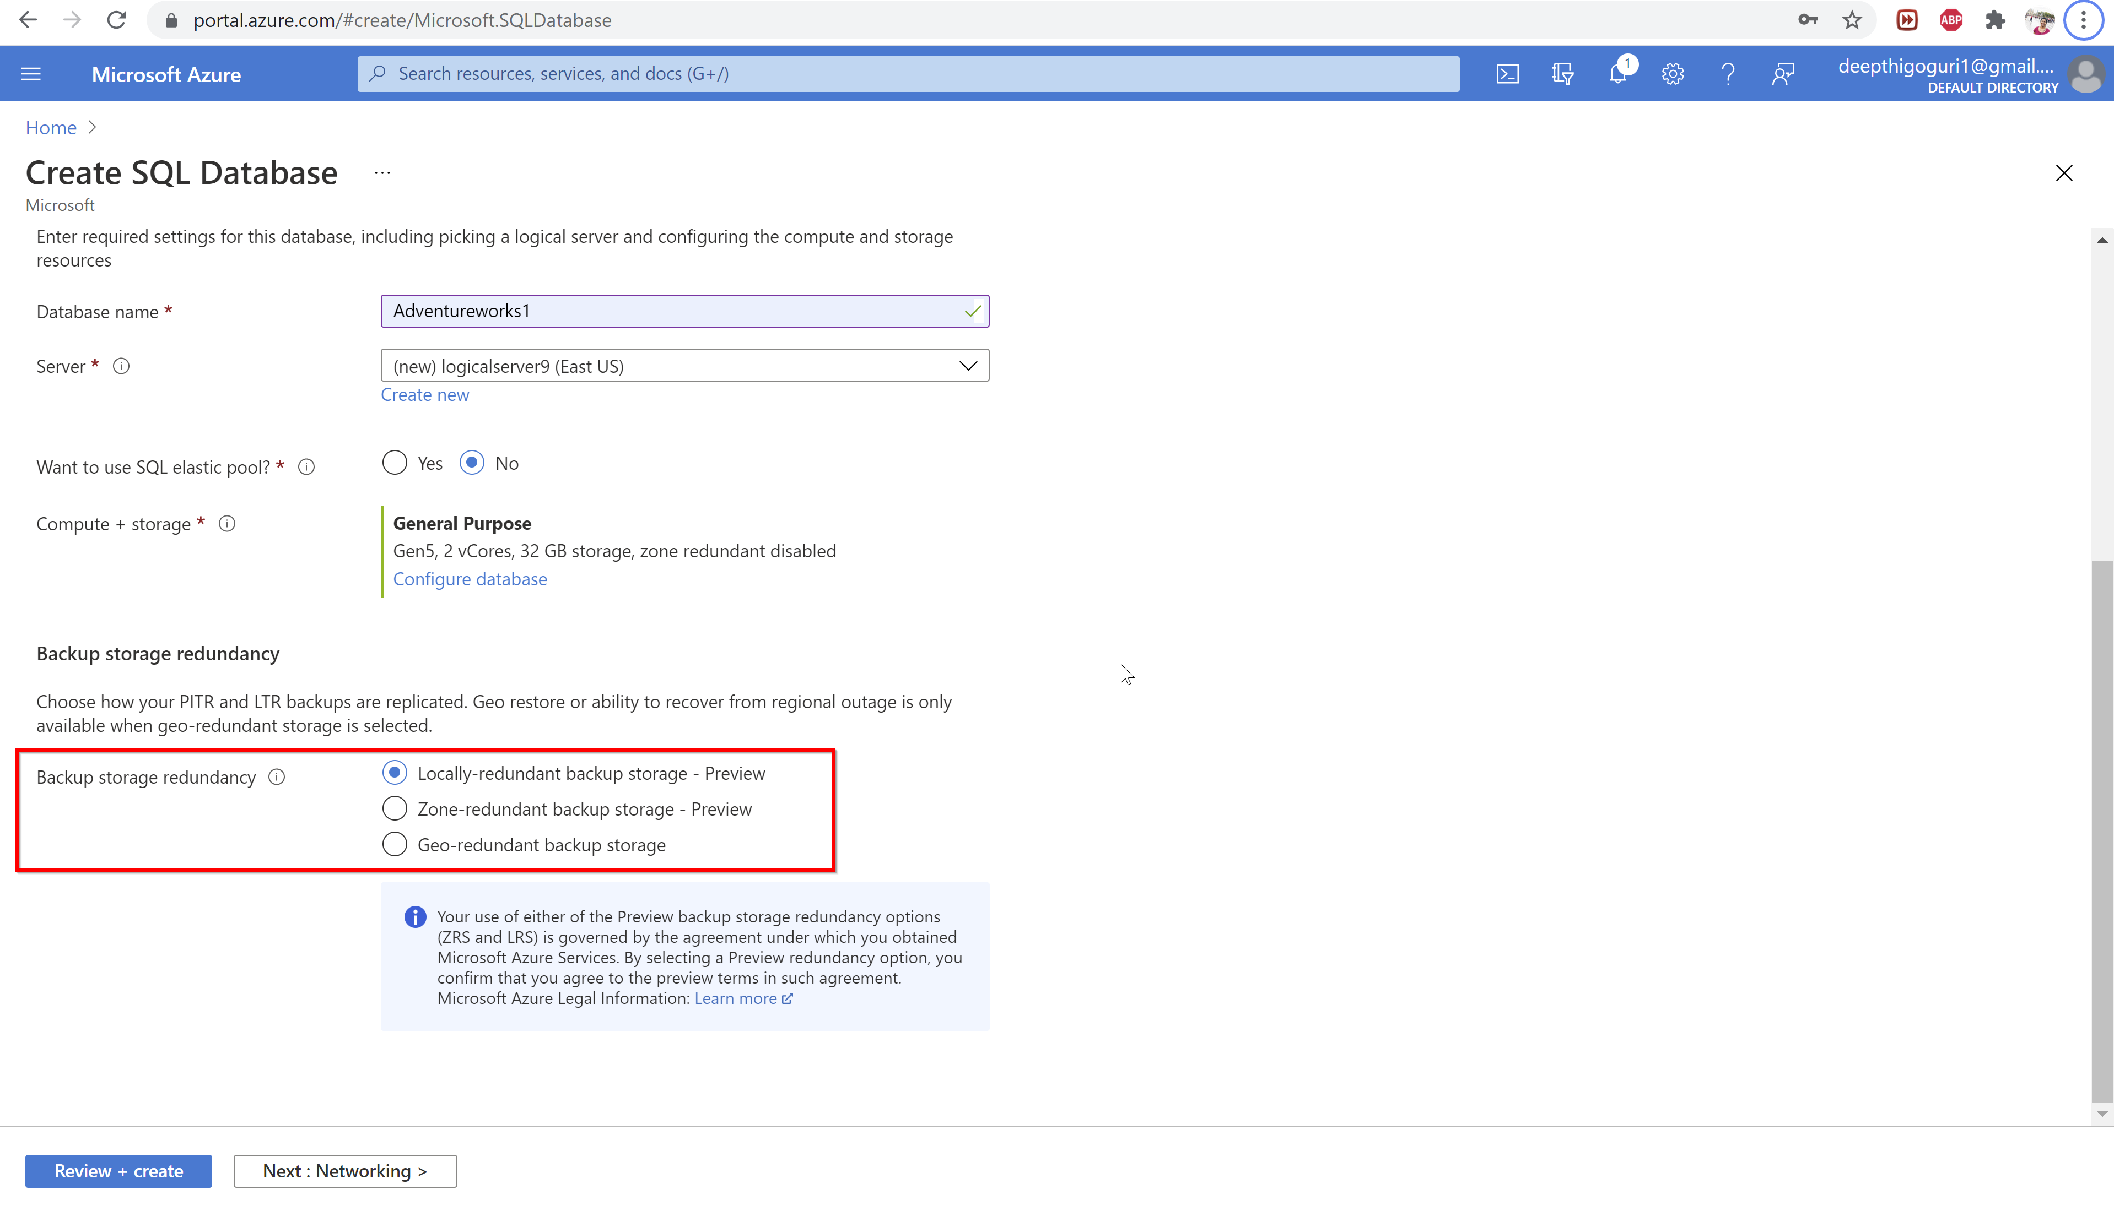

Slide 42
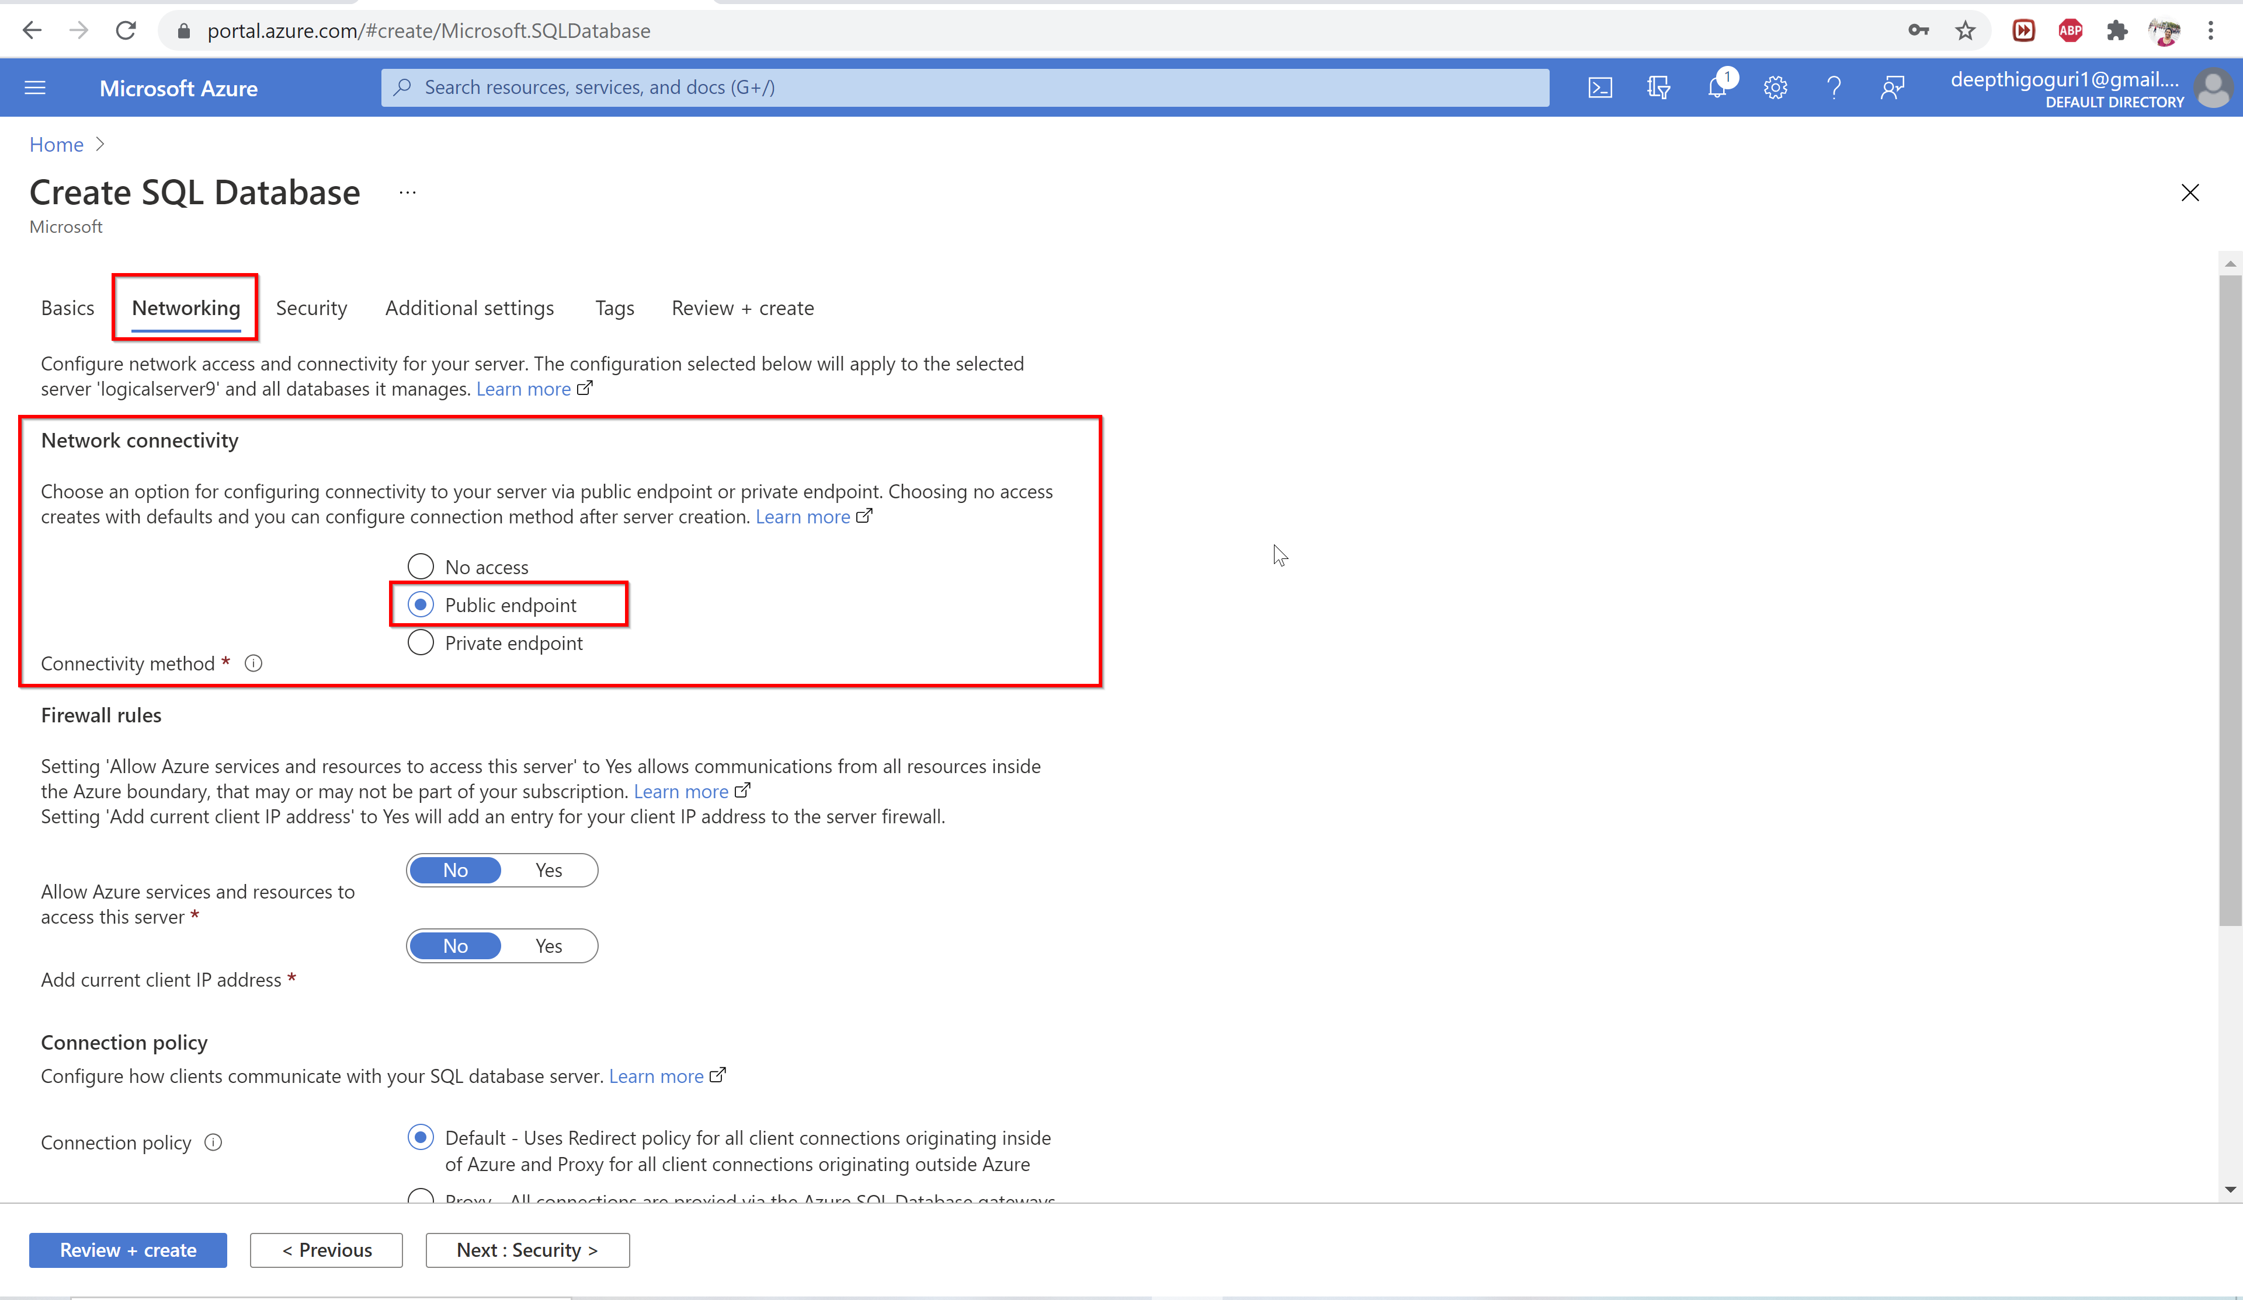

Slide 43
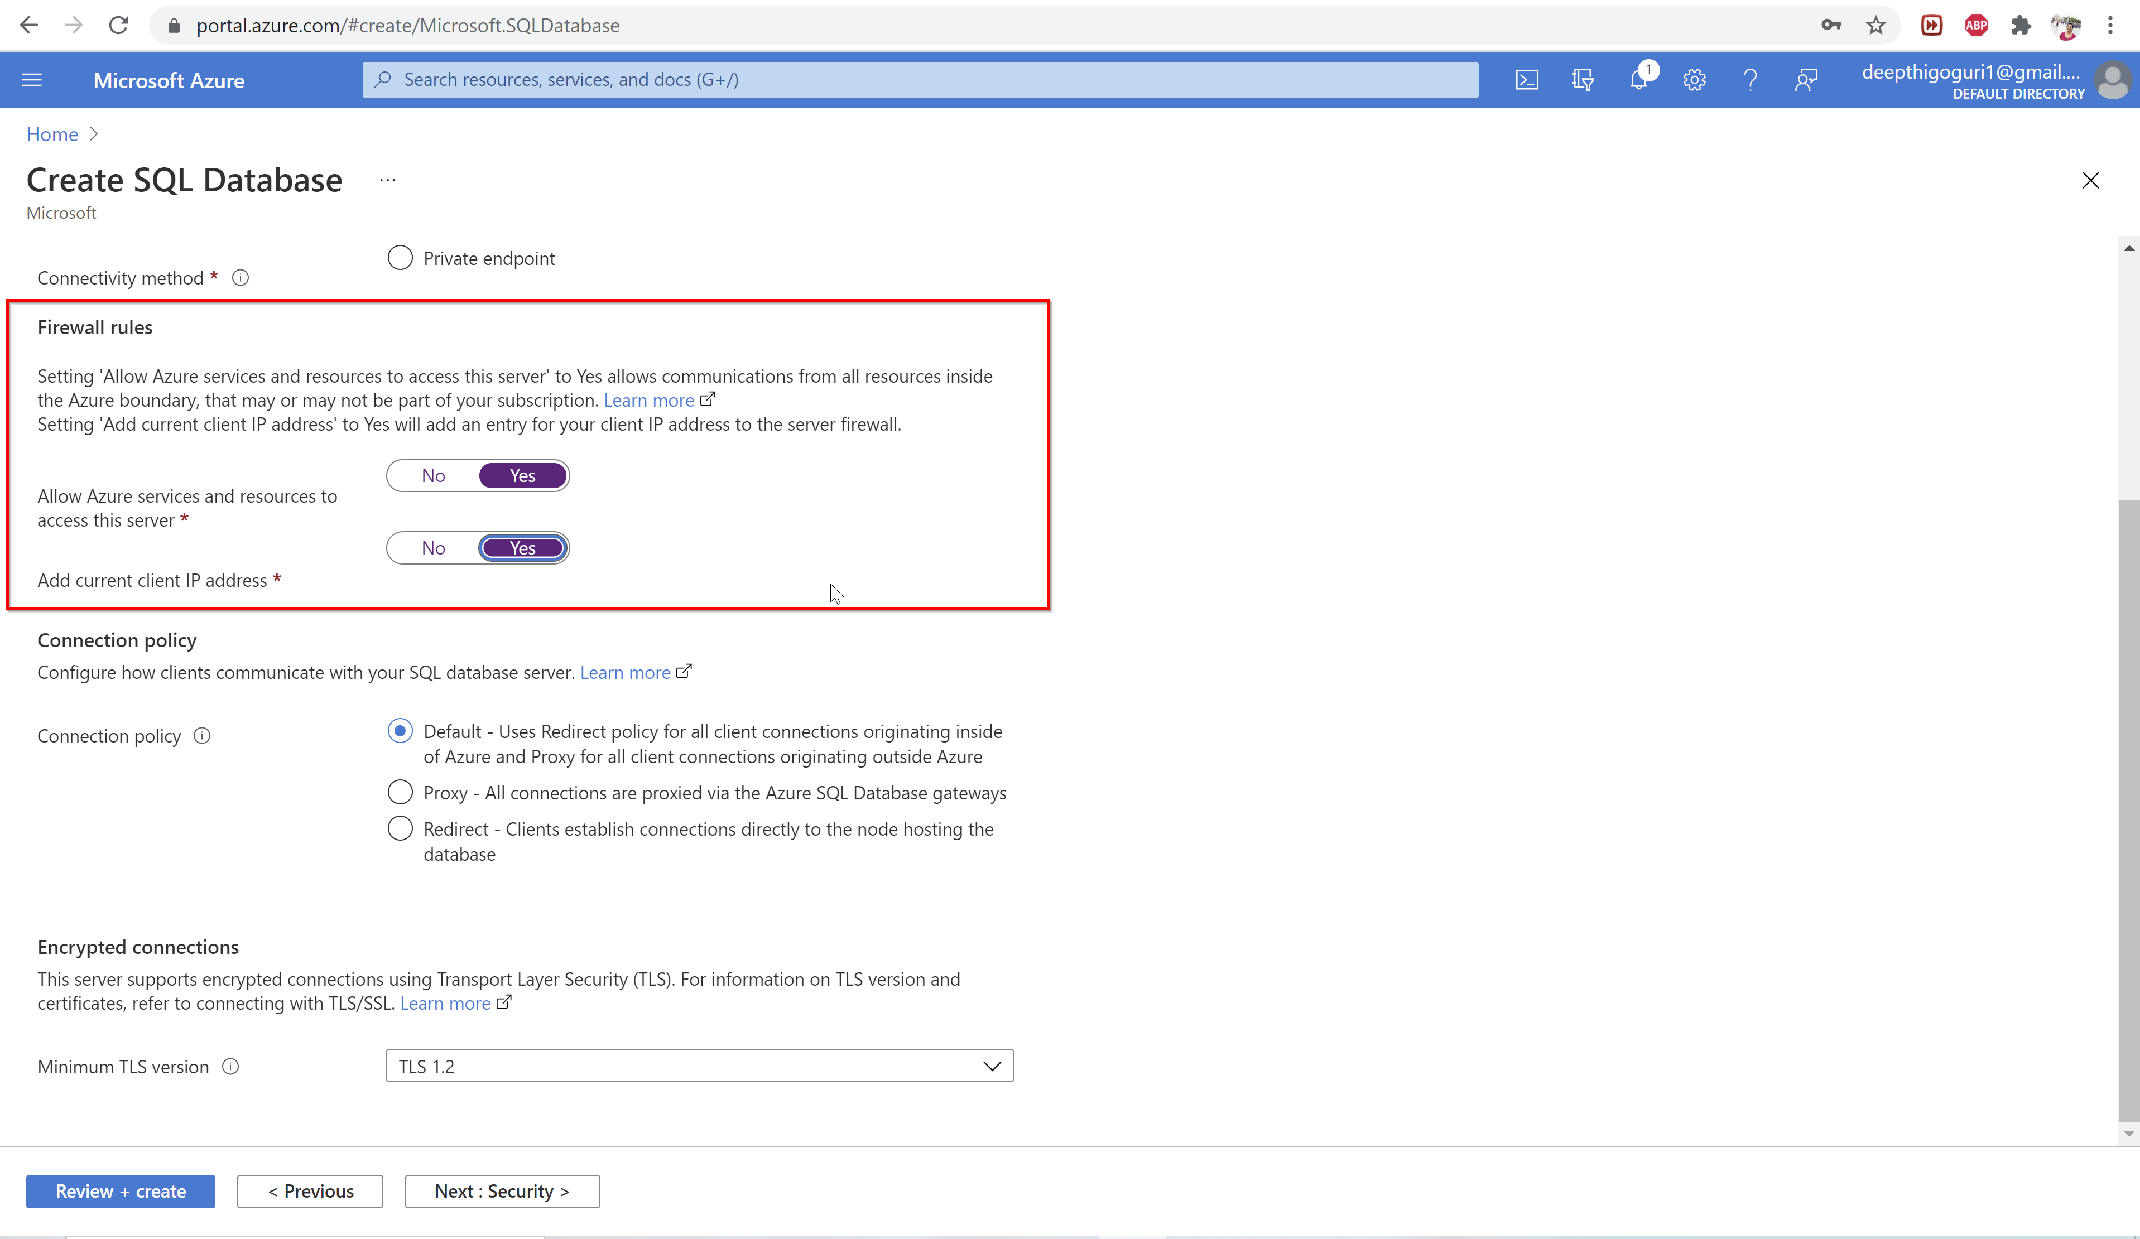

Slide 44
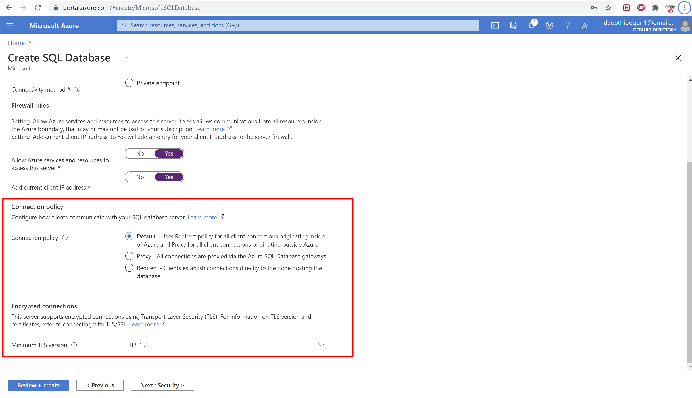

Slide 45
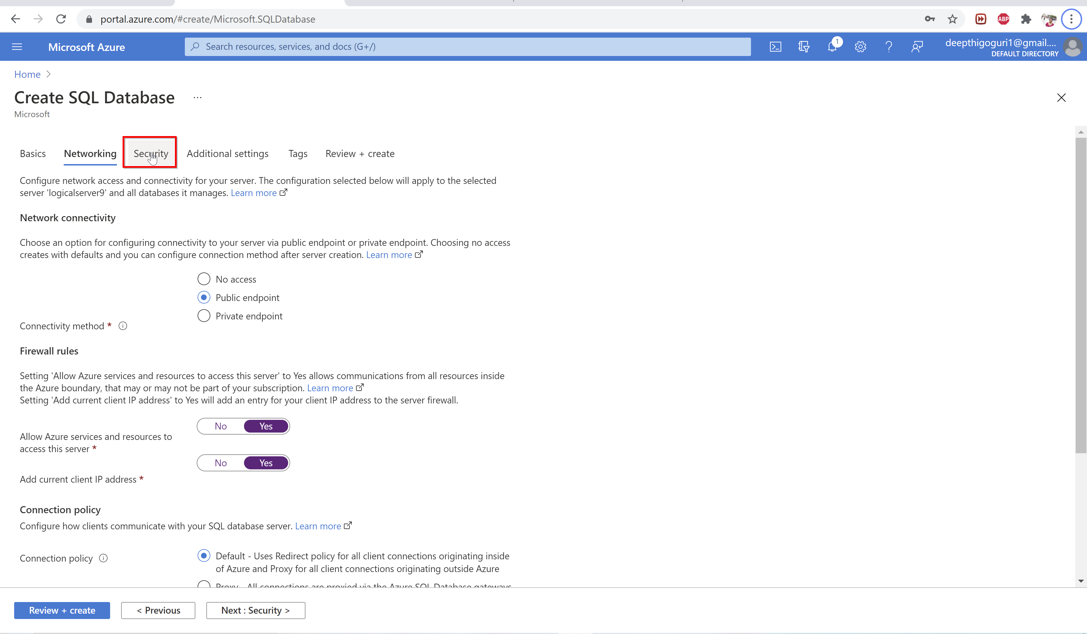

Slide 46
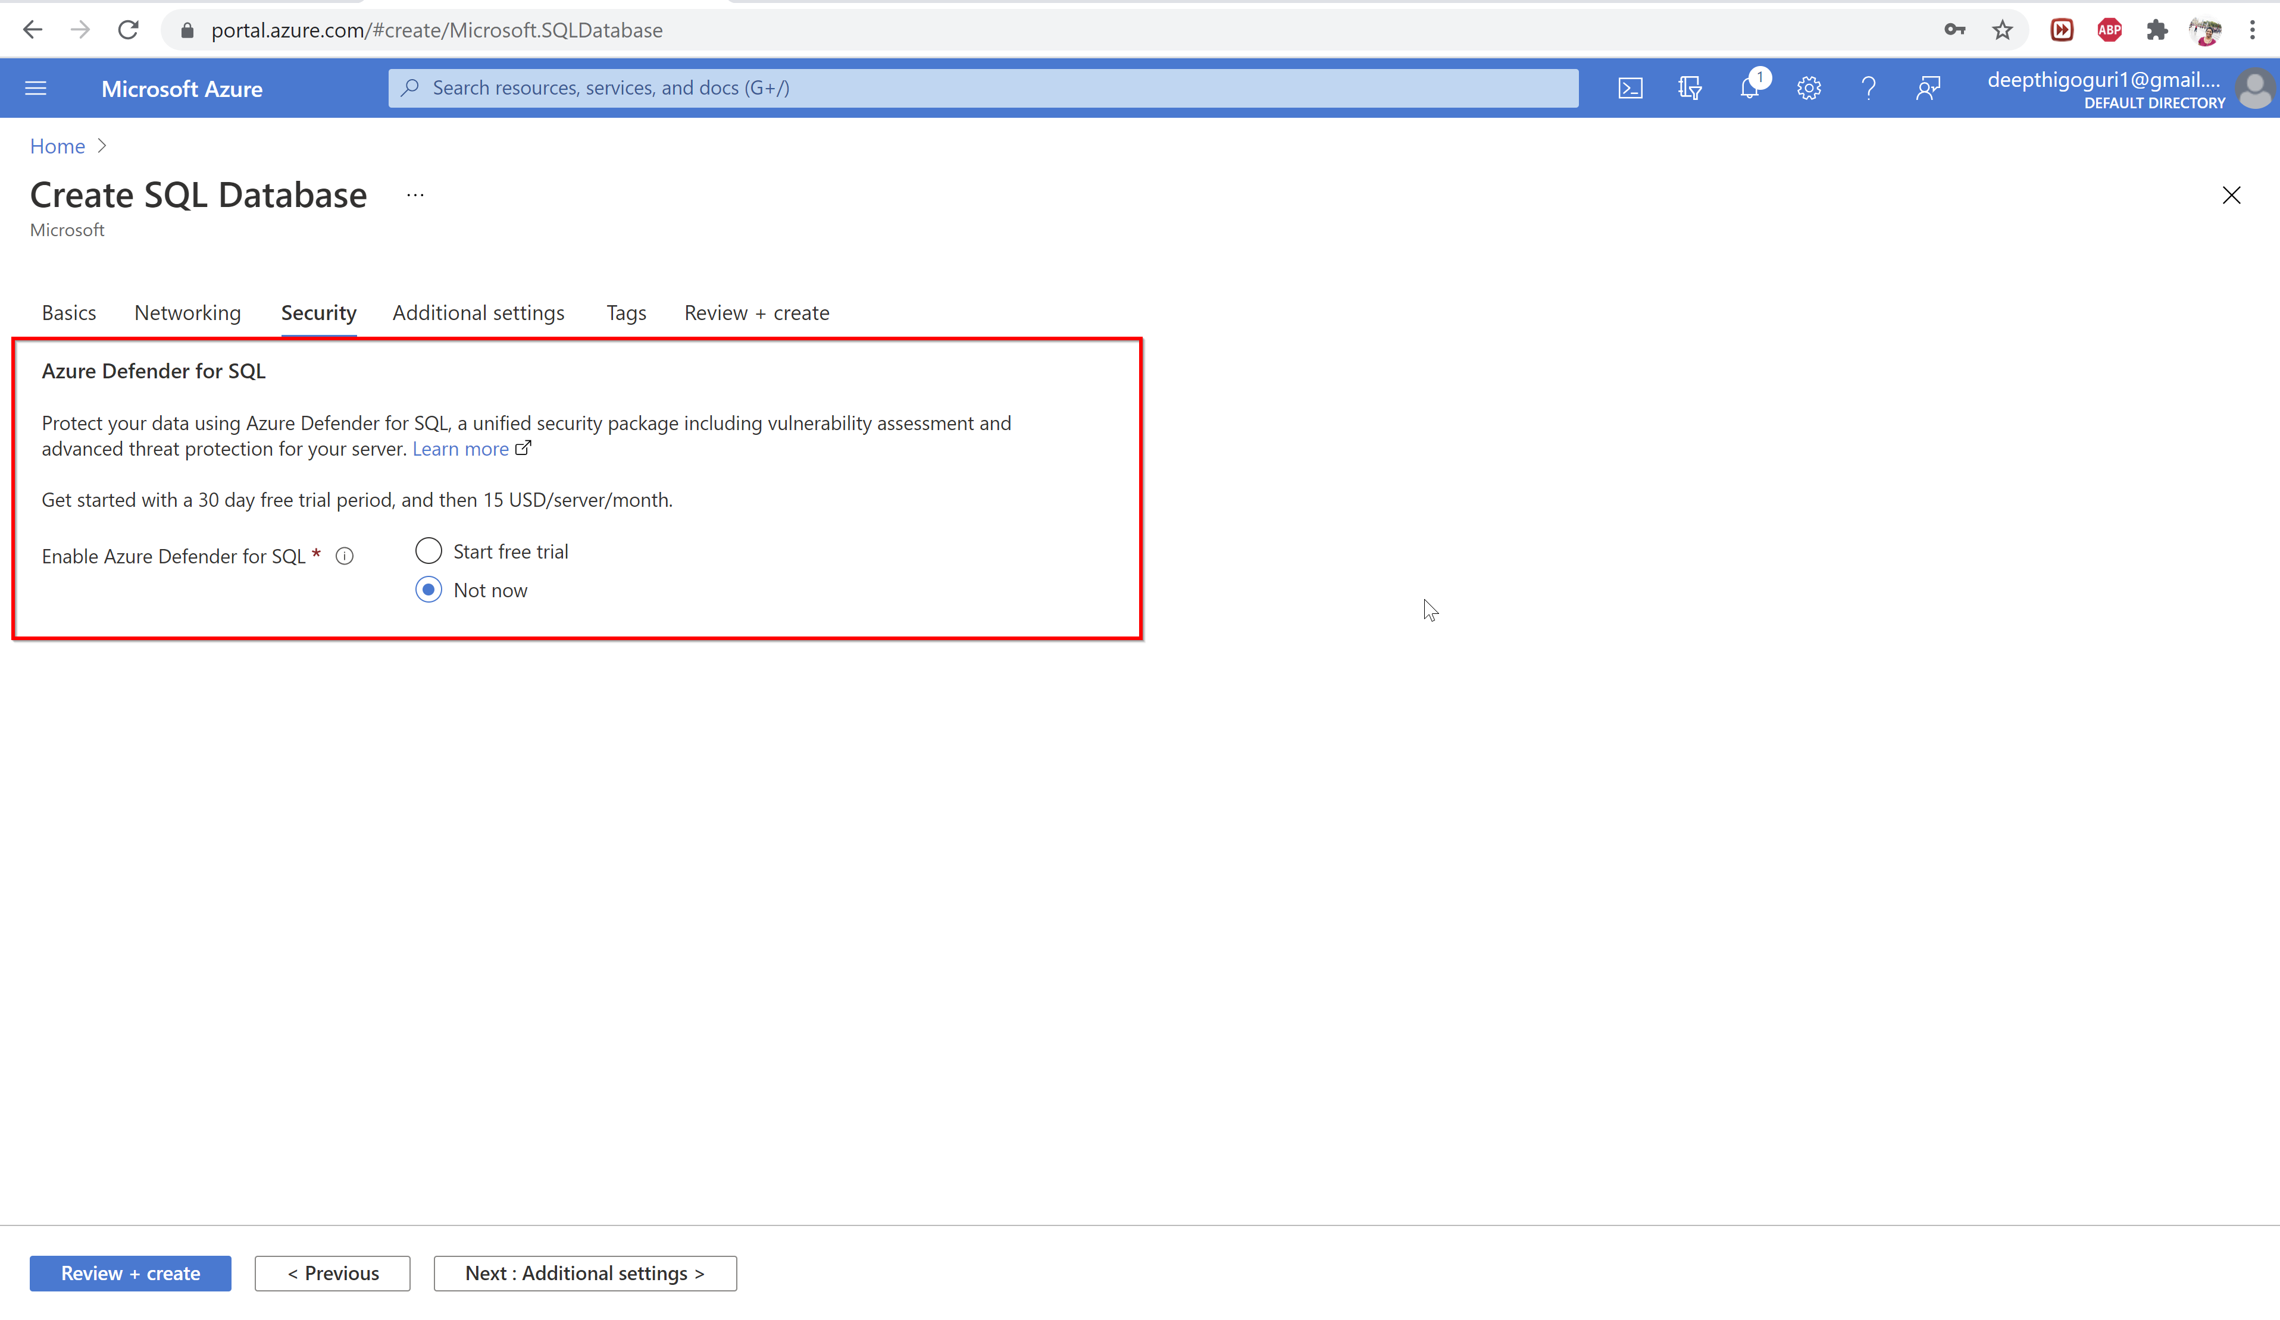

Slide 47
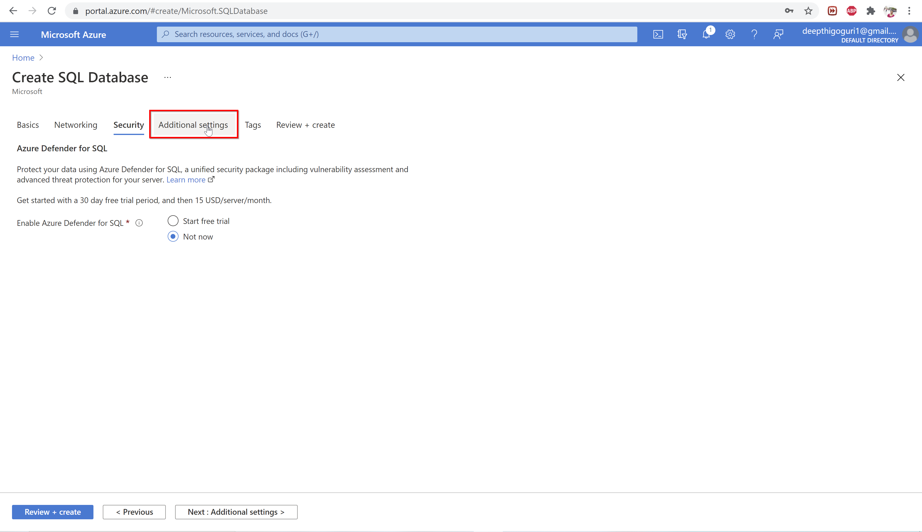

Slide 48
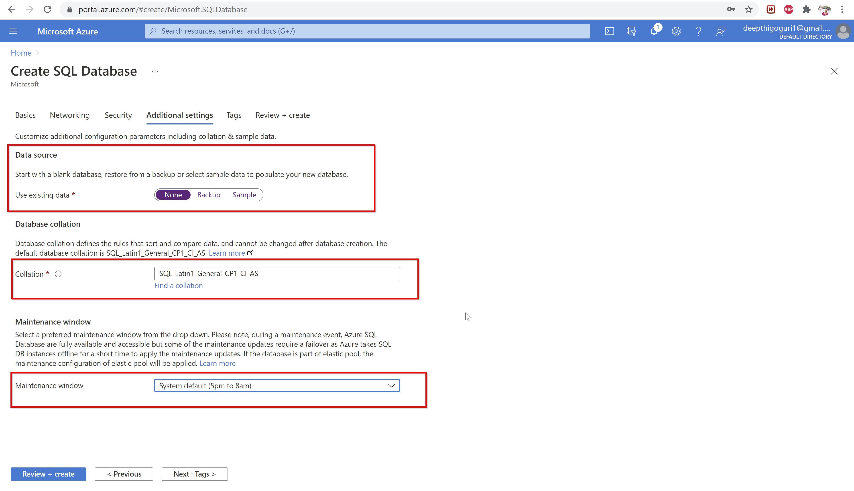

Slide 49
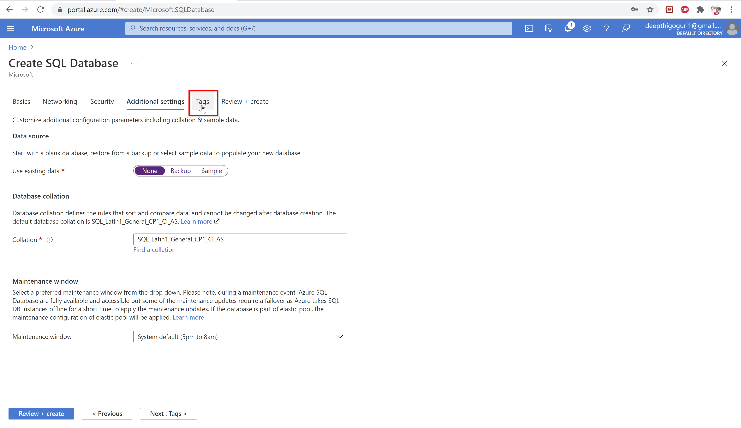

Slide 50
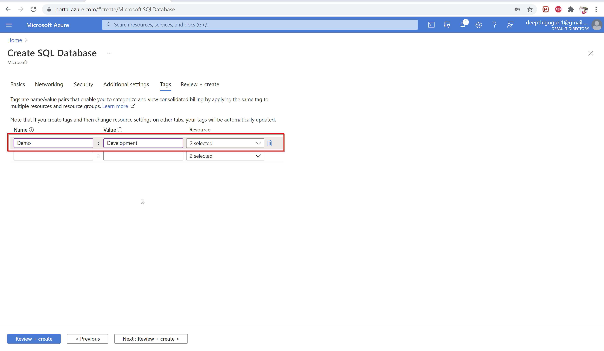

Slide 51
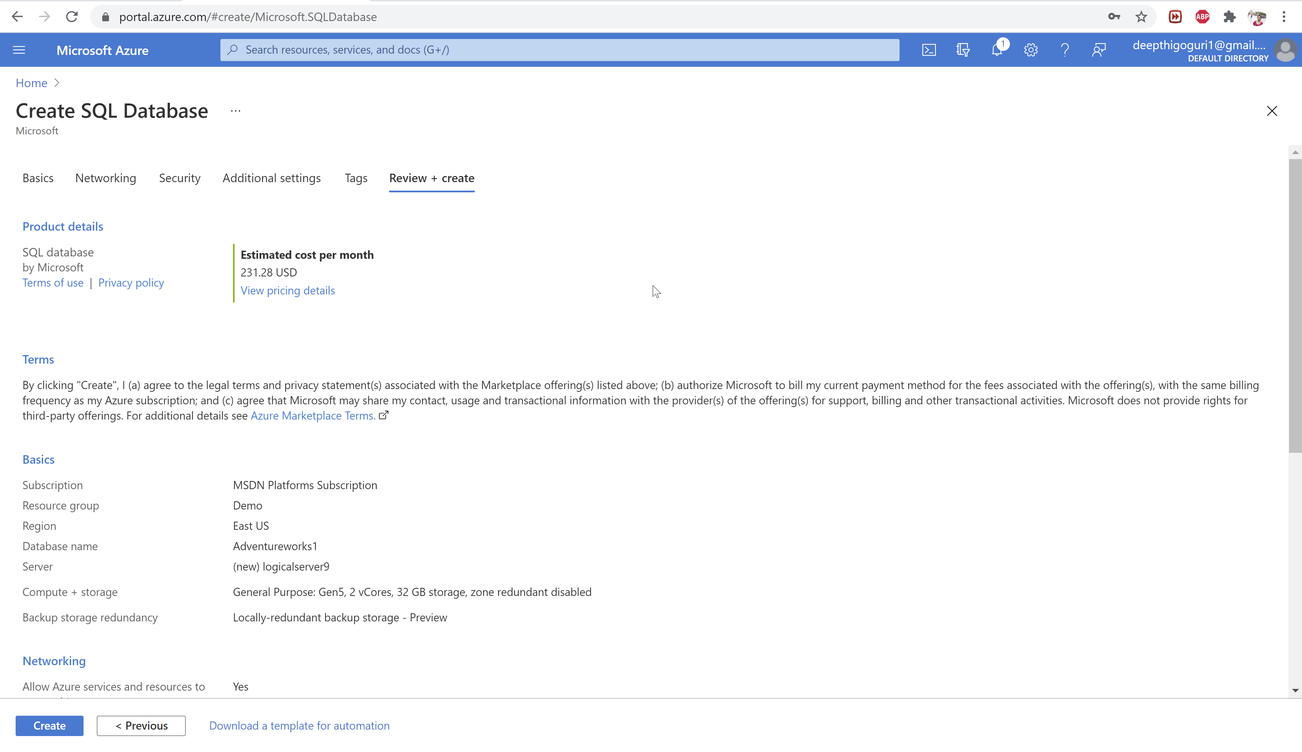

Slide 52
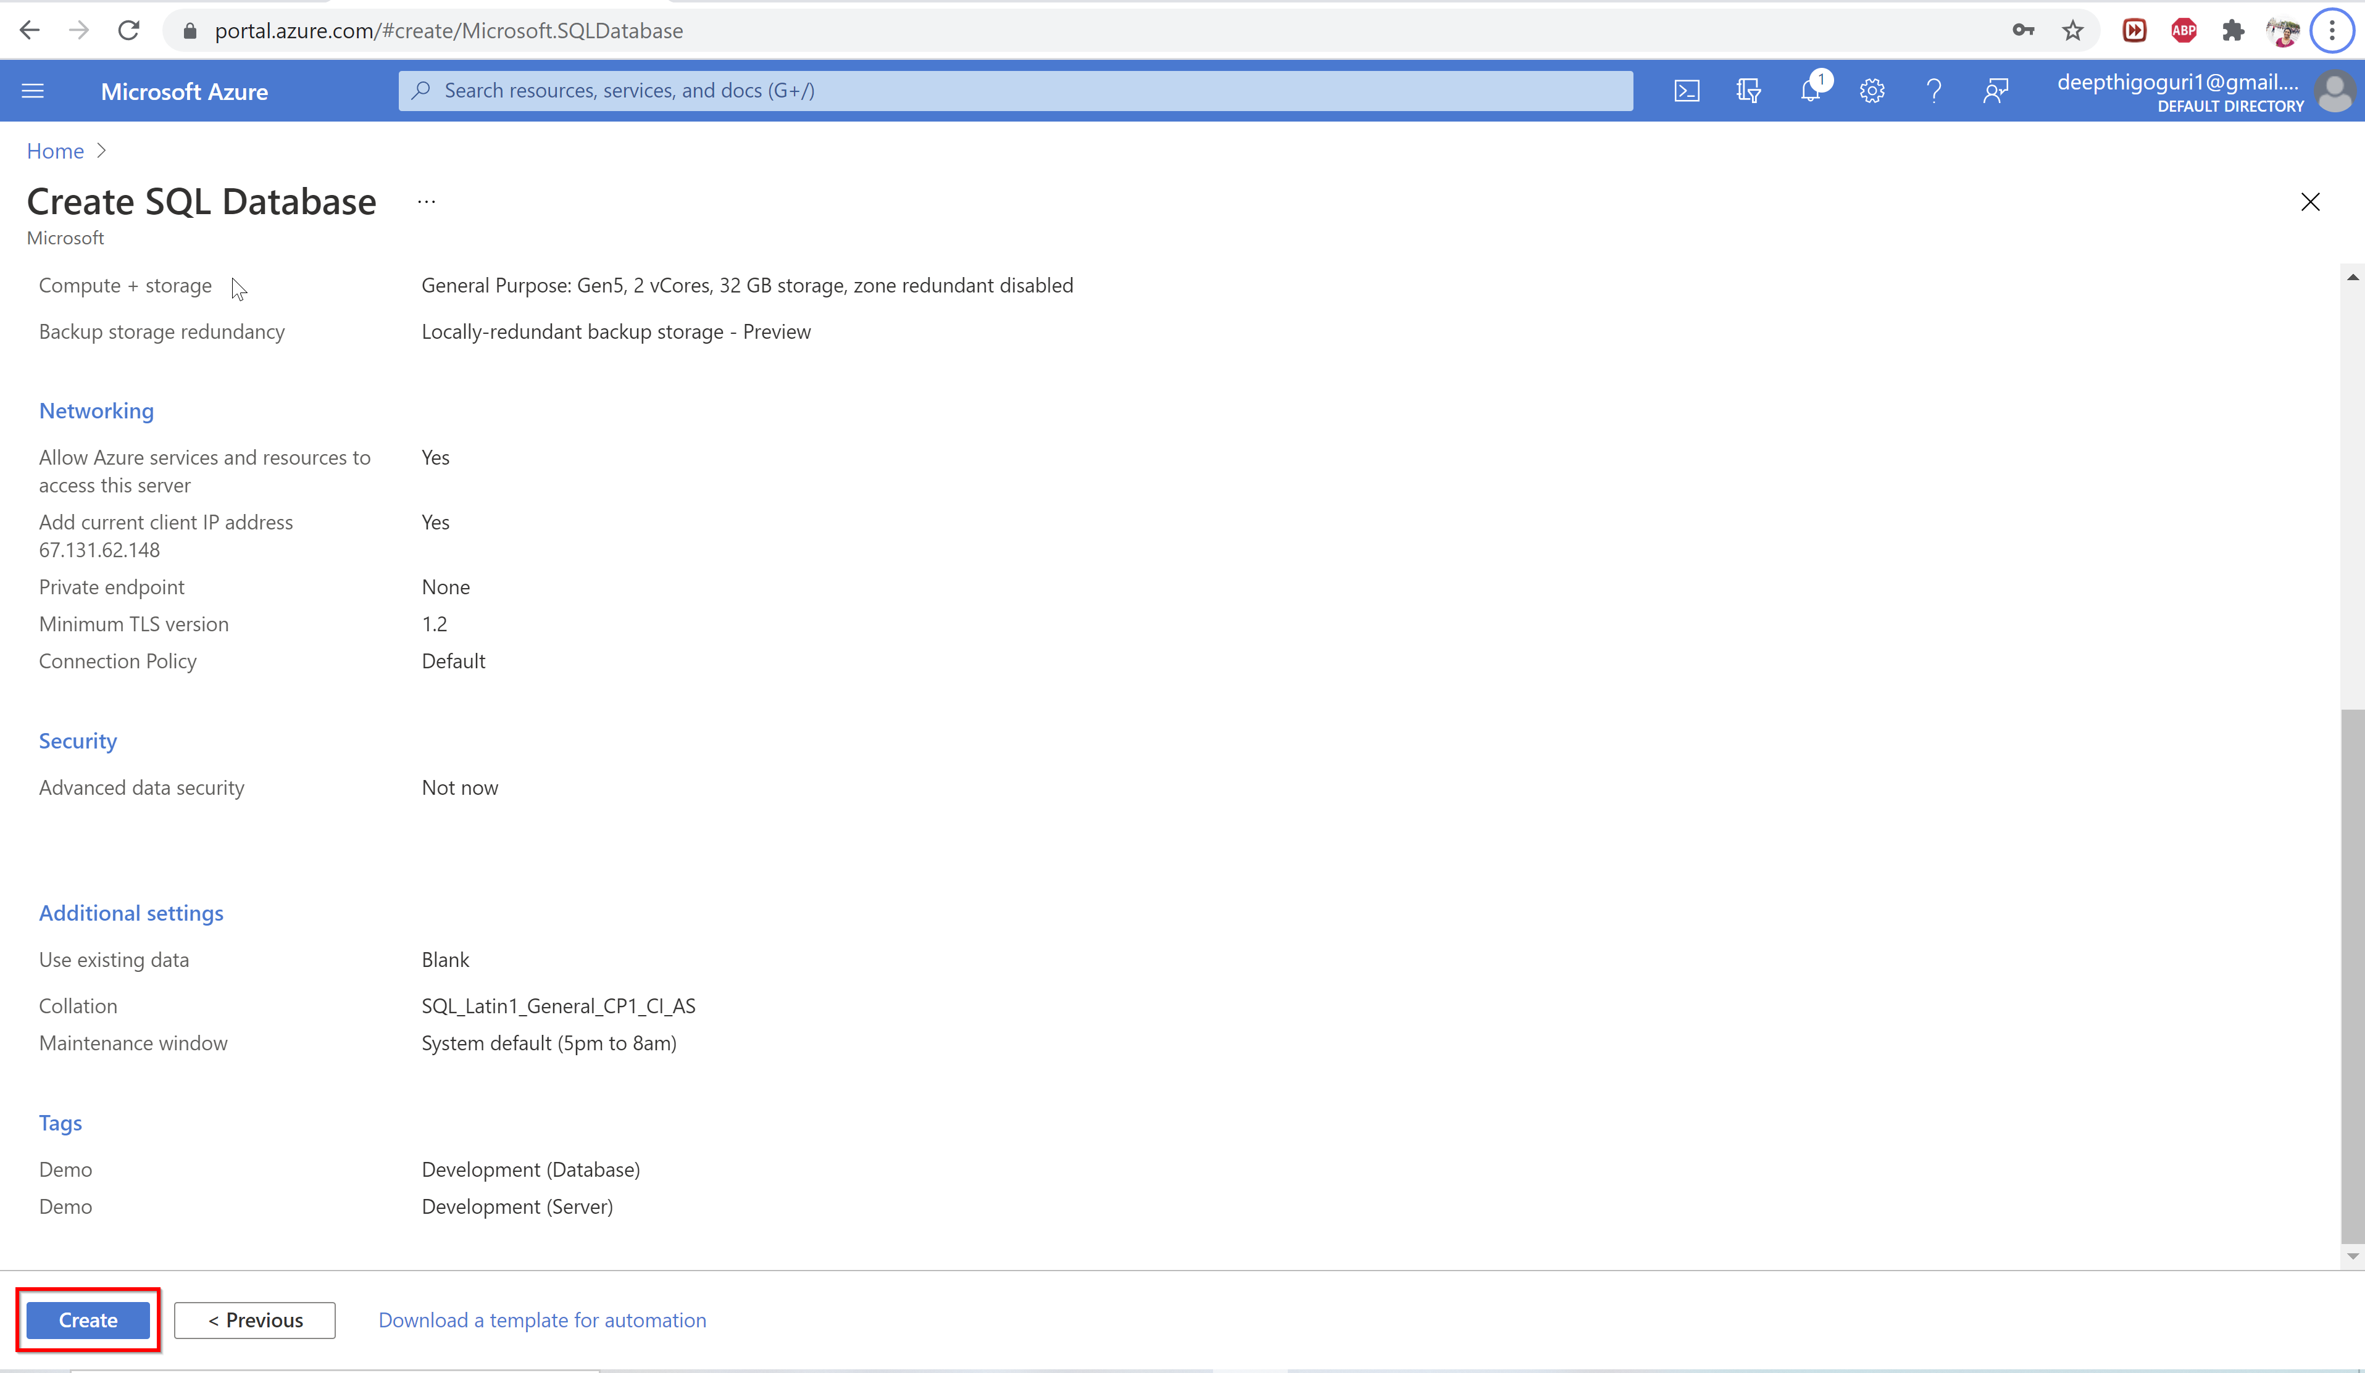

Slide 53
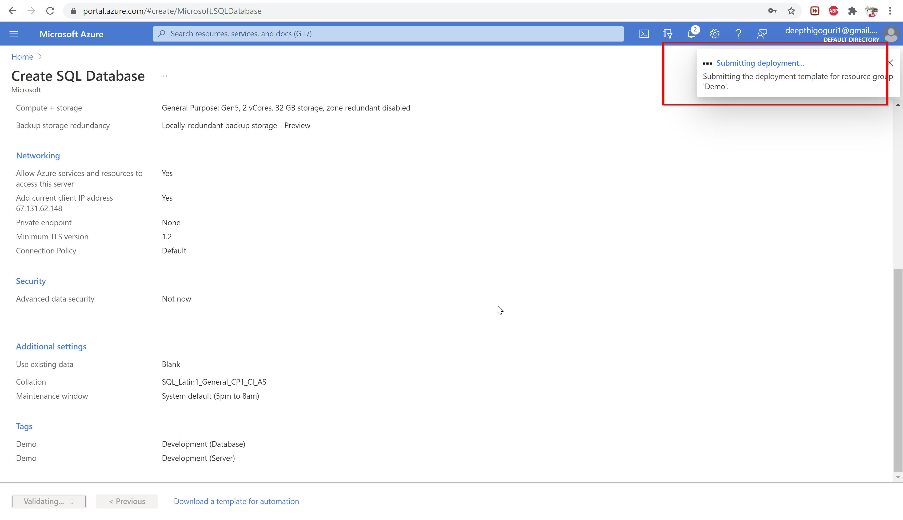

Slide 54
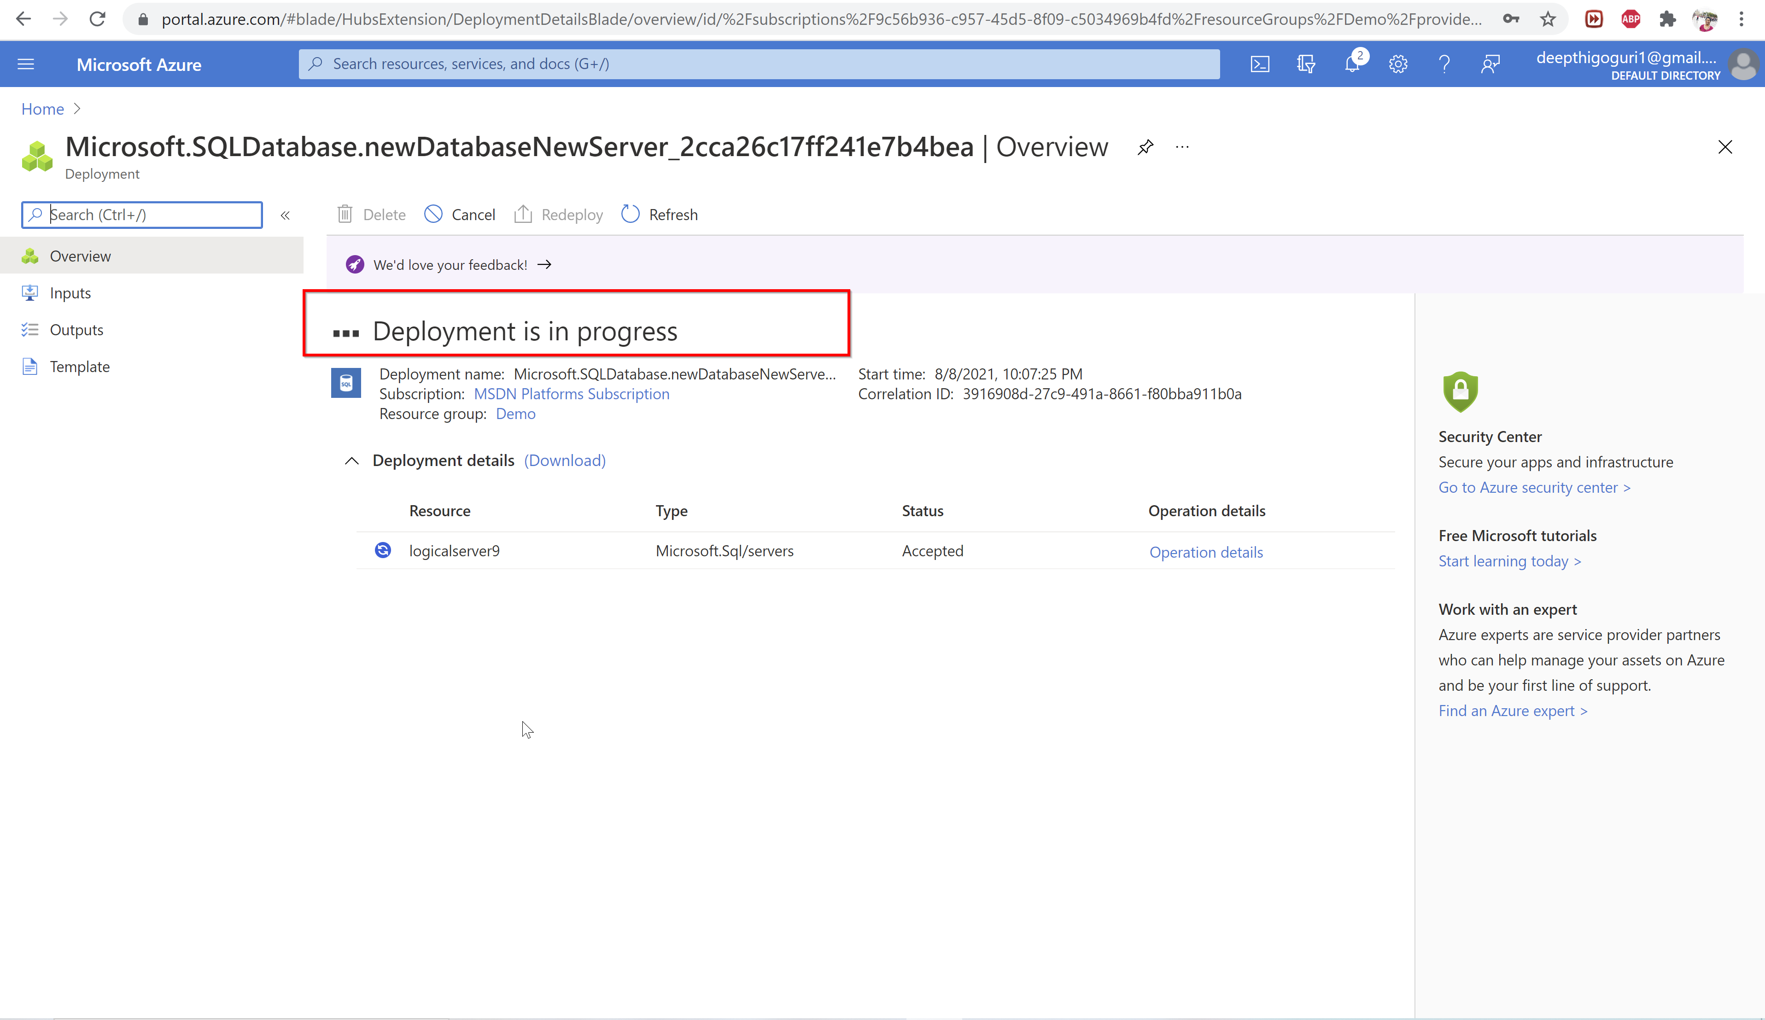

Slide 55
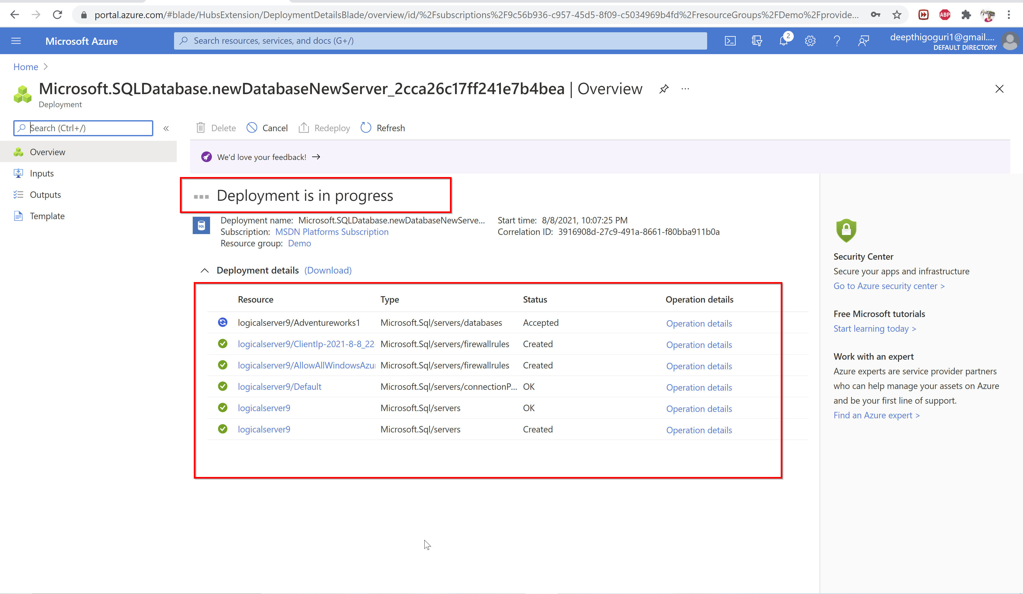

Slide 56
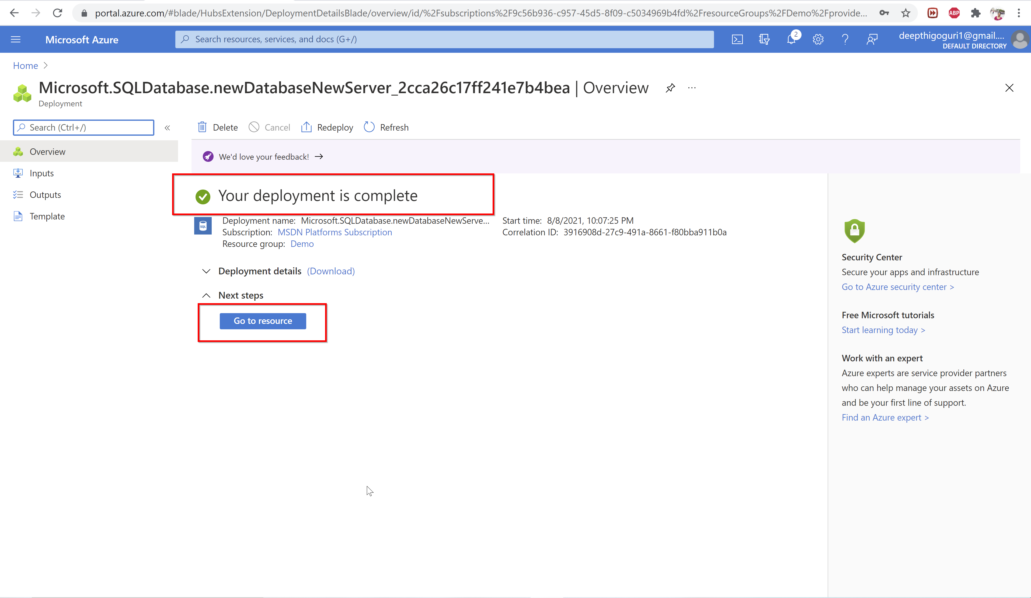

Slide 57
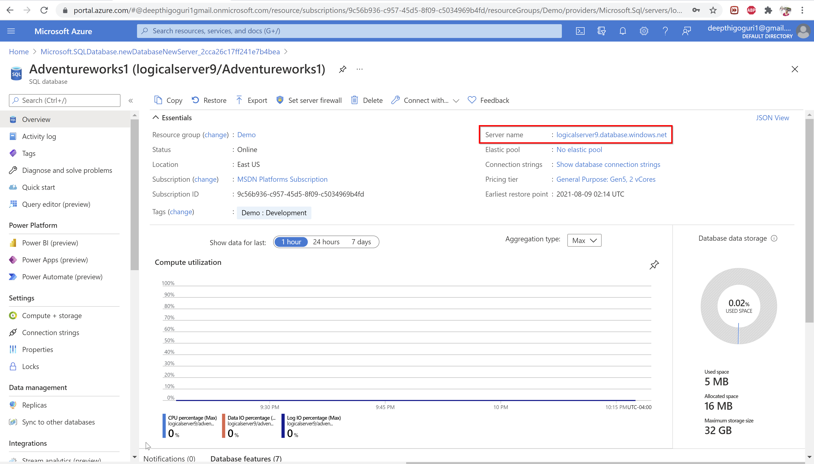

Slide 58
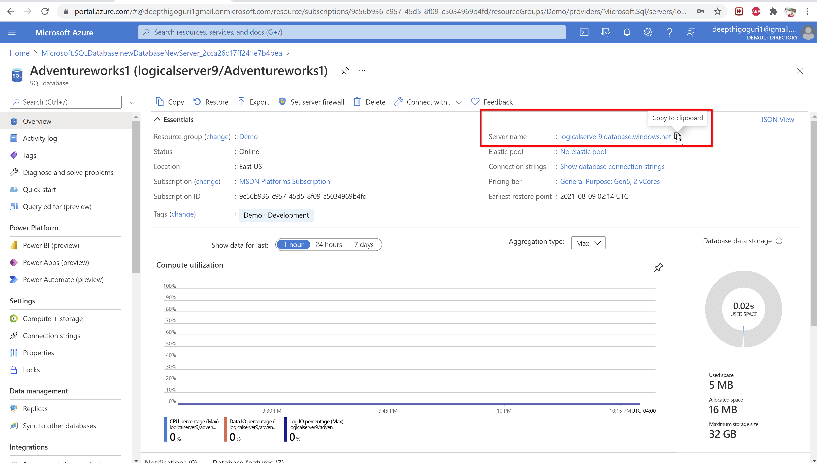

Slide 59
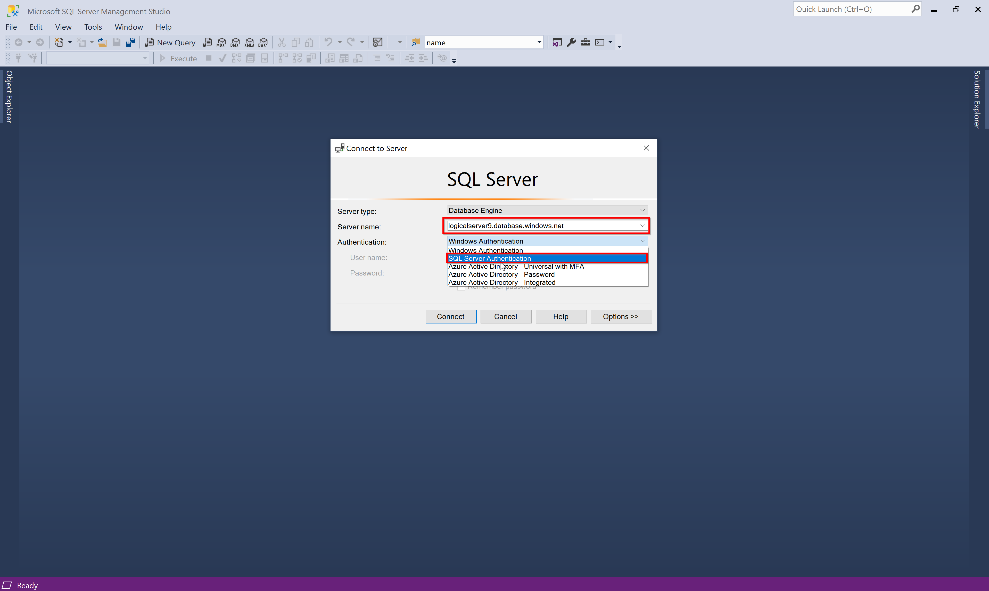

Slide 60
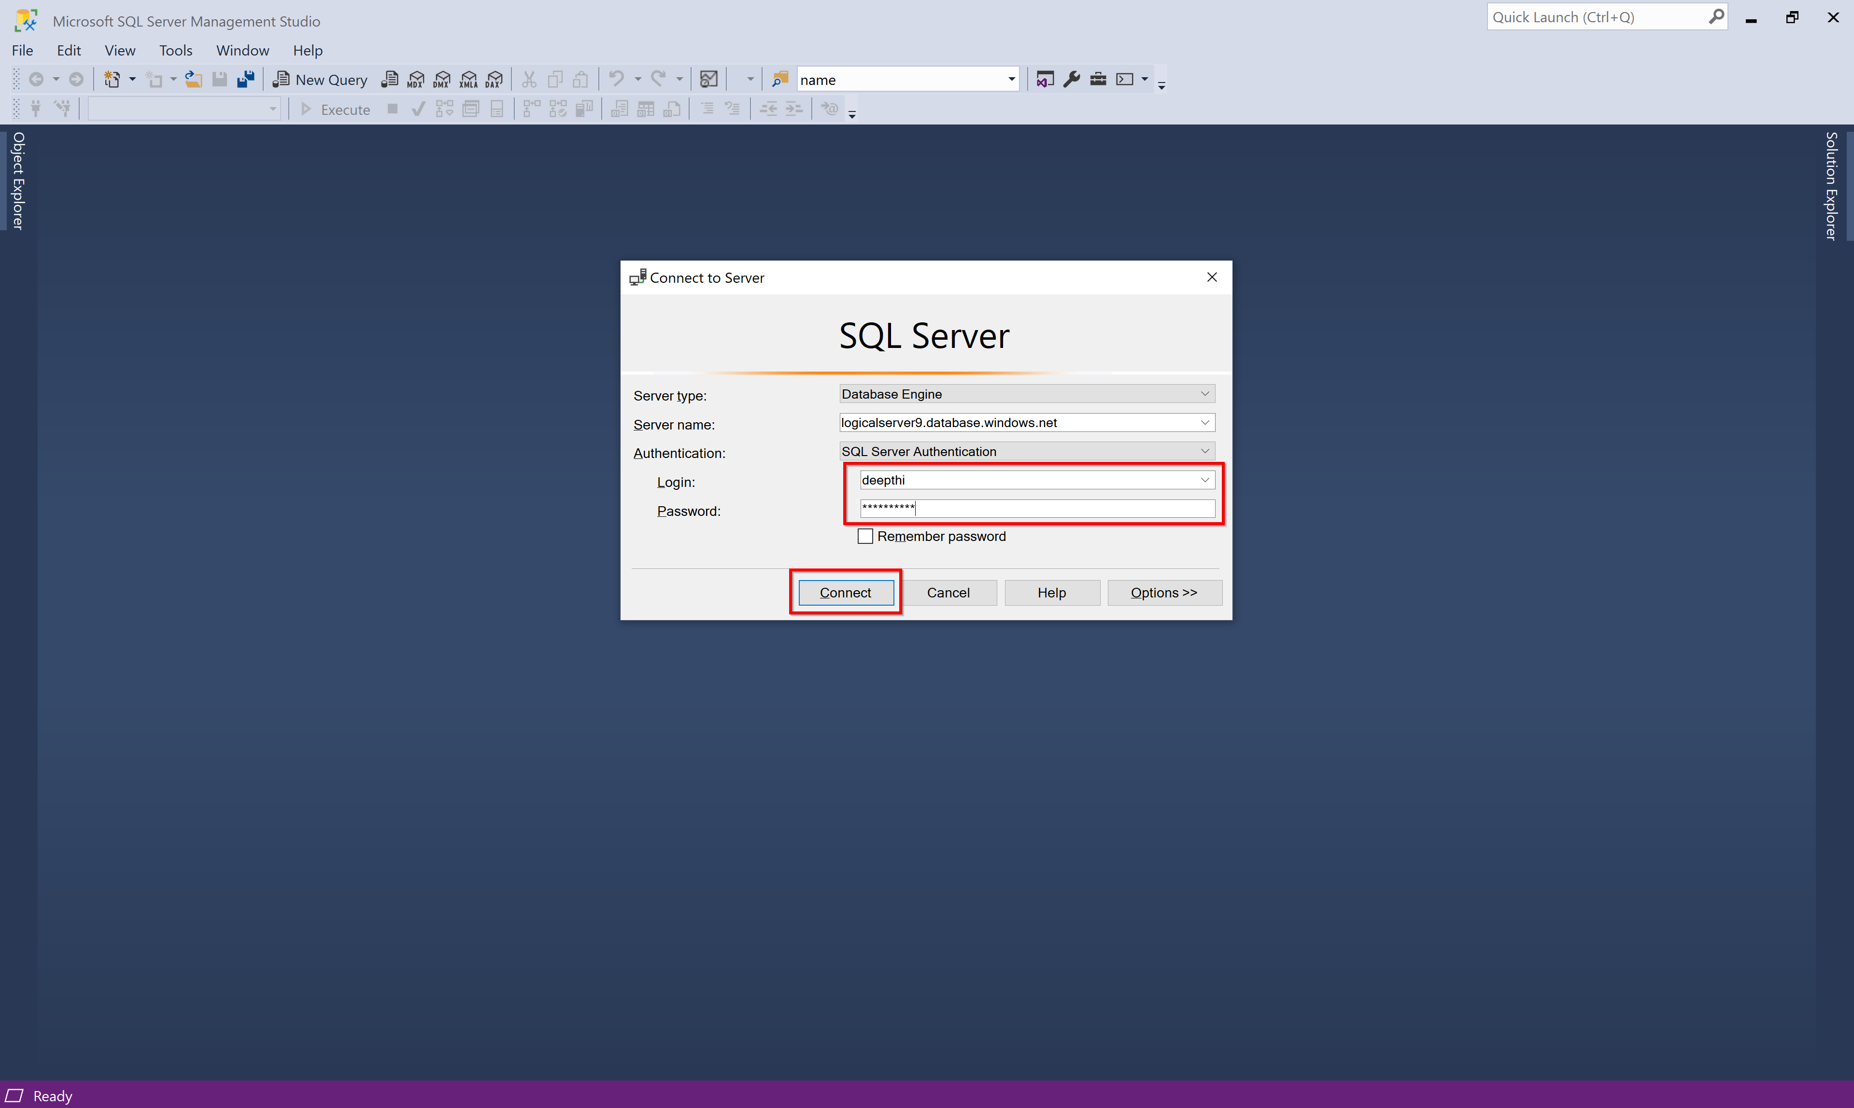

Slide 61
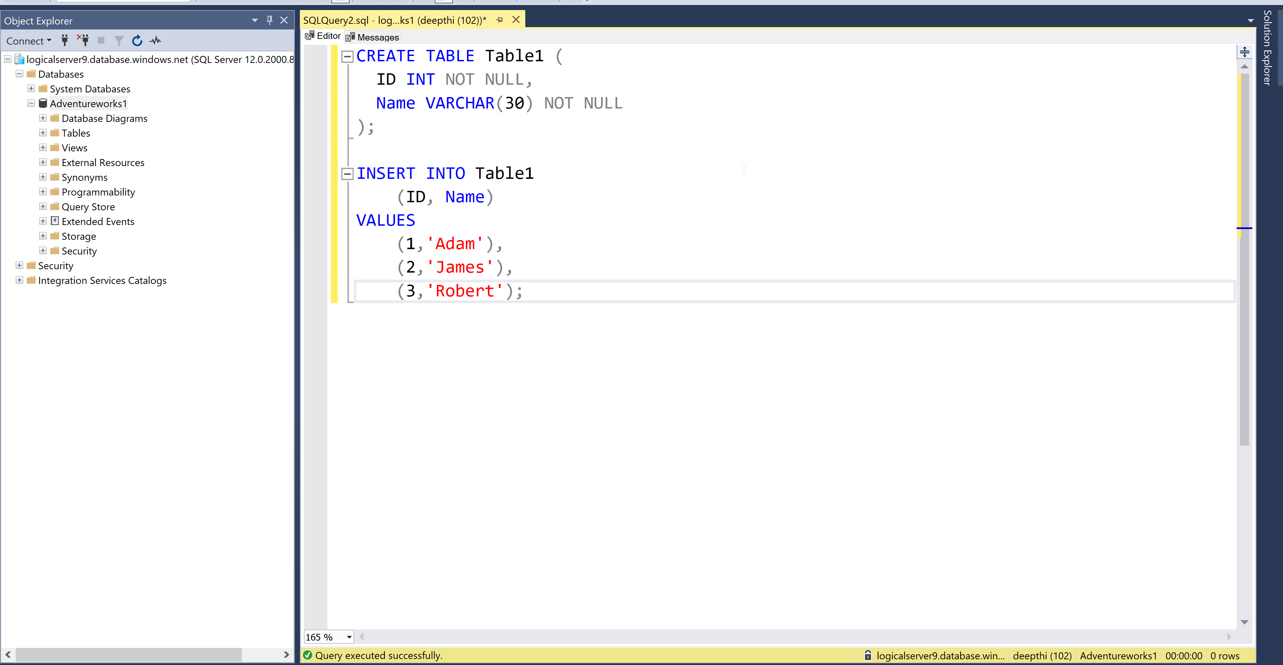

Slide 62
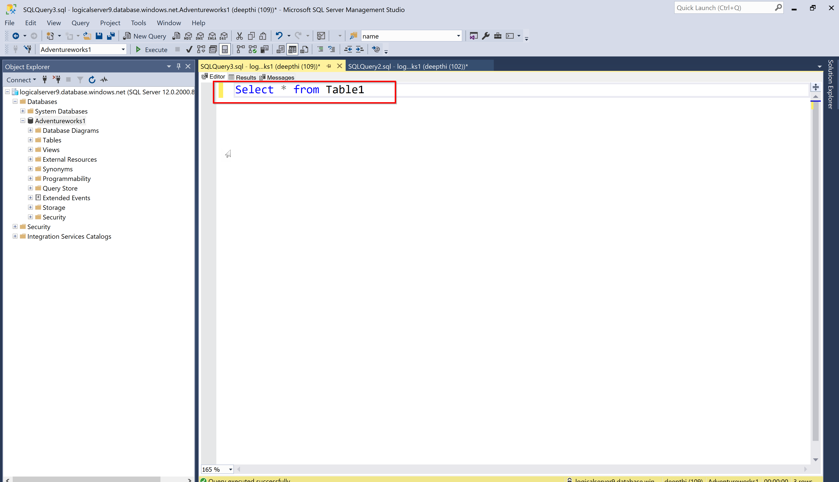

Slide 63
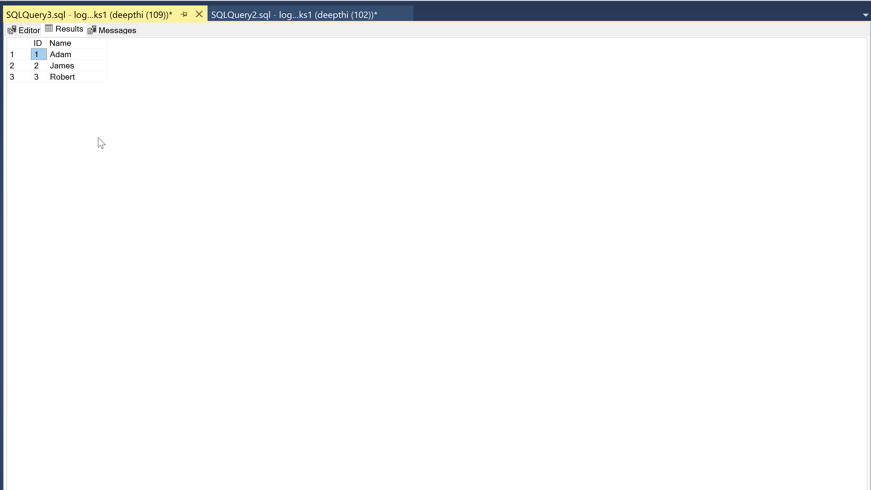

Slide 64
Backup and Restore

Slide 65
Backup and Restore
Globally replicated storage
Every week once – Full backup
Every 5-10 Minutes – T-logs
Every 12 hours once – Diff backup

Slide 66
How to take
manual backup?

Slide 67
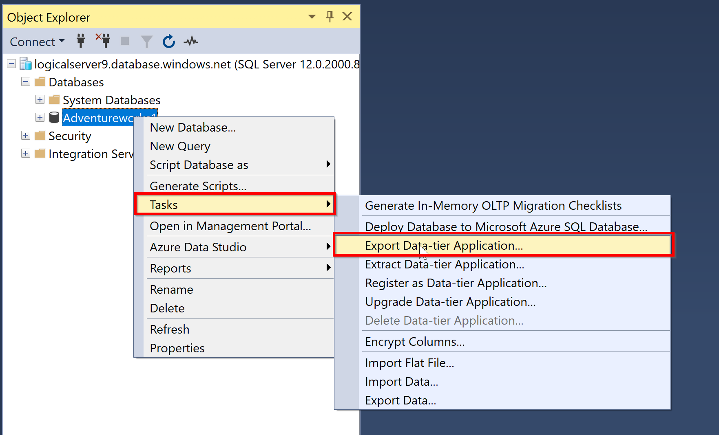

Slide 68
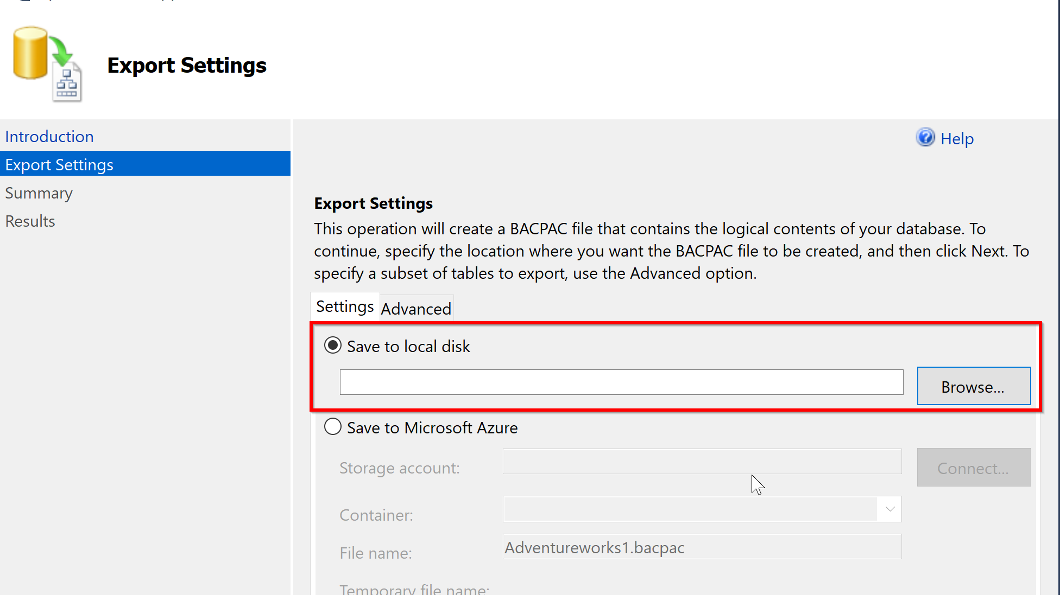

Slide 69
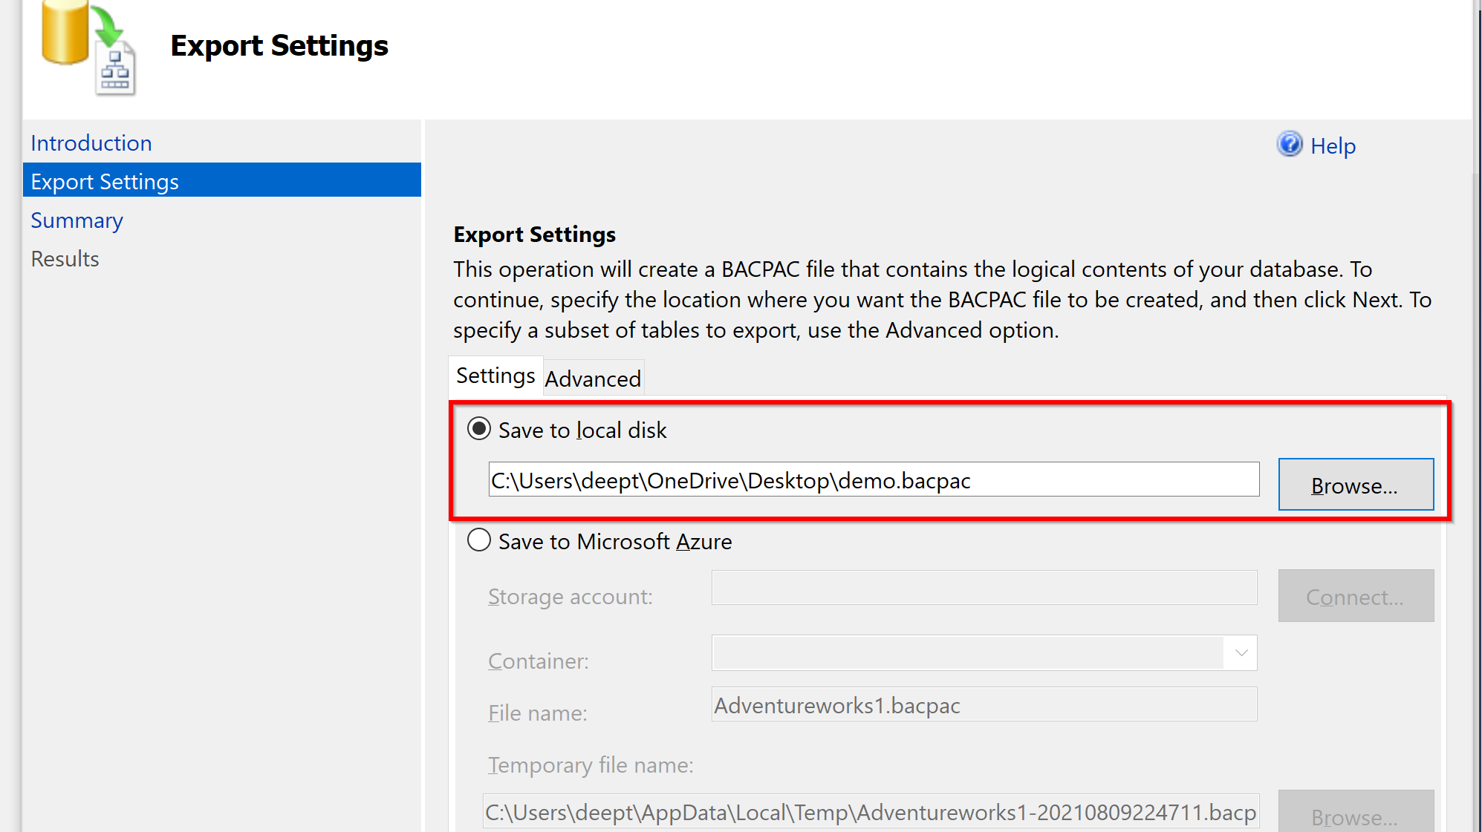

Slide 70


Slide 71
Backup using
Azure Data studio
Notes:
Ok lets spend the majority of time looking at some demo’s

Slide 72


Slide 73
Tools for migration
Notes:
Ok lets spend the majority of time looking at some demo’s

Slide 74
Tools for migration
Azure TCO (Total cost of Ownership) calculator for estimating the costs
Migrations: SKU recommender Azure SQL
Data Migration Assistant-Check for any compatibility issues
SQL Azure Migration Wizard
Azure Database Migration Services

Slide 75
Key Takeaway’s
DBA Jobs are going to be here
Azure SQL is cool
Easy to Learn
Anyone can get started
Intelligent Performance
Saves money
Less Maintenance

Slide 76
Start your Azure journey
Microsoft Docs
Microsoft Learn TV
Channel9
Azure SQL Fundamentals
SQL Workshops
Azure SQL
Microsoft Virtual Training Days

Slide 77
Resources
https://docs.microsoft.com/en-us/learn/paths/azure-sql-fundamentals/

Slide 78





PASSMN
We’re always looking for speakers, sponsors, and new members. Contact us!
Minnesota Data and Analytics User Group Azure Data Tech Group Community Member
Meetup:
https://www.meetup.com/MN-SQL-Server-User-Group-PASSMN/
Email:
board@passmn.com
LinkedIn:
https://www.linkedin.com/groups/2034949/
Twitter:
@PASSMN - https://twitter.com/PASSMN
Code of Conduct:
https://passmn.com/code-of-conduct/

Slide 79
Thank you!

